Slide 1
Characterising the (Greater) Mancunian model
Prof. Alan Harding
Presentation to IDEHATE Territories and Mobilities 2025 programme, Study Visit to Manchester, 21 May 2025

Slide 2
Preliminaries: ‘devolution’ or centralisation?
50 years ago, local government in the UK:
Ran most schools, operated most local public transport, owned and managed much housing stock (e.g. 60% of homes in Manchester), provided higher level technical education, ran most care homes for vulnerable young and old people
Today, after 50 years of centralisation, privatisation and marketisation, most local authorities do NONE of these things
Without the leadership shown by Greater Manchester, there would have been no ‘devolution’ in England
However subnational autonomy in England is far weaker than in the rest of the UK and most comparable developed countries
The process described here has only begun to return a fraction of the resources and powers national governments have taken away from local authorities in the last half century.

Slide 3
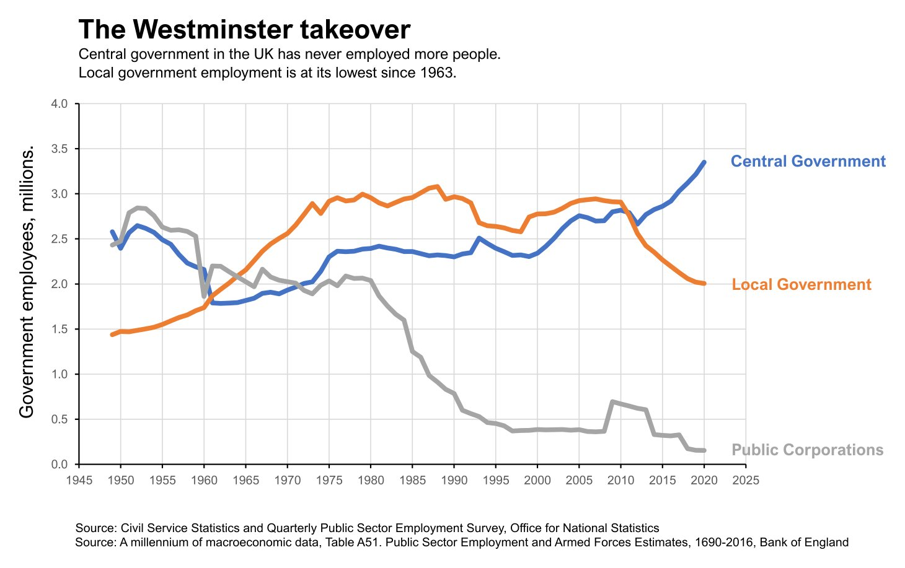
Post-war UK public sector employment trends

Slide 4
Overview of Greater Manchester

Slide 5
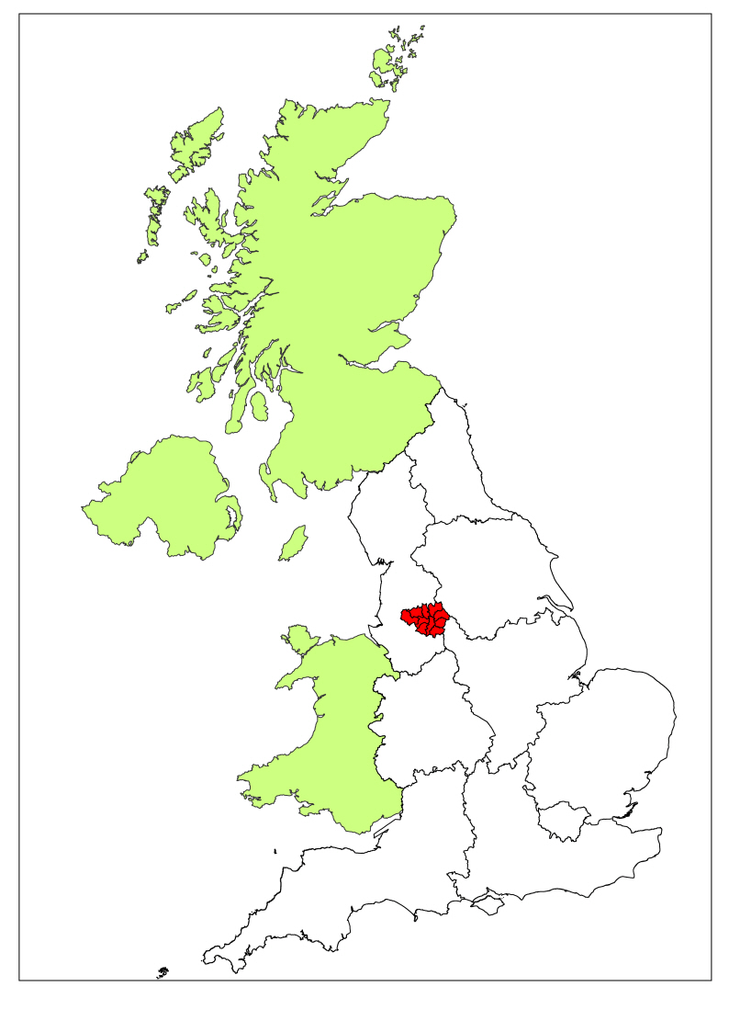
GM & the nations & regions of the UK

Slide 6
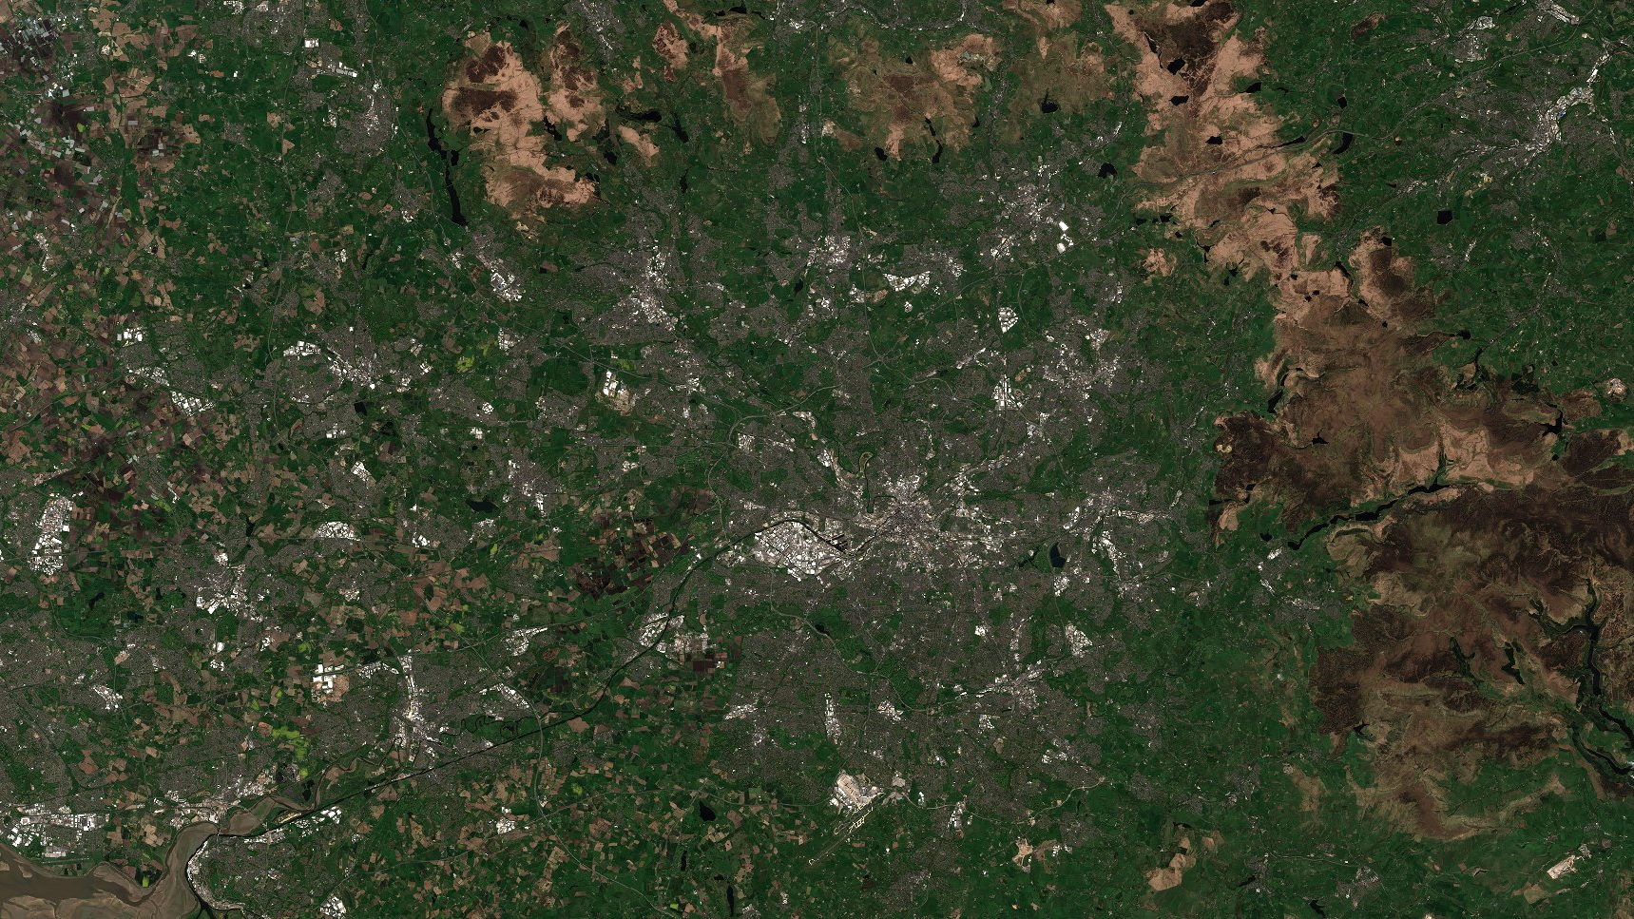


Rochdale
Bury
Bolton
Oldham
Wigan
Salford
Tameside
Manchester
Trafford
Stockport
ESA Sentinel 2/Sentinel Hub EO Browser CC-BY-4.0

Slide 7
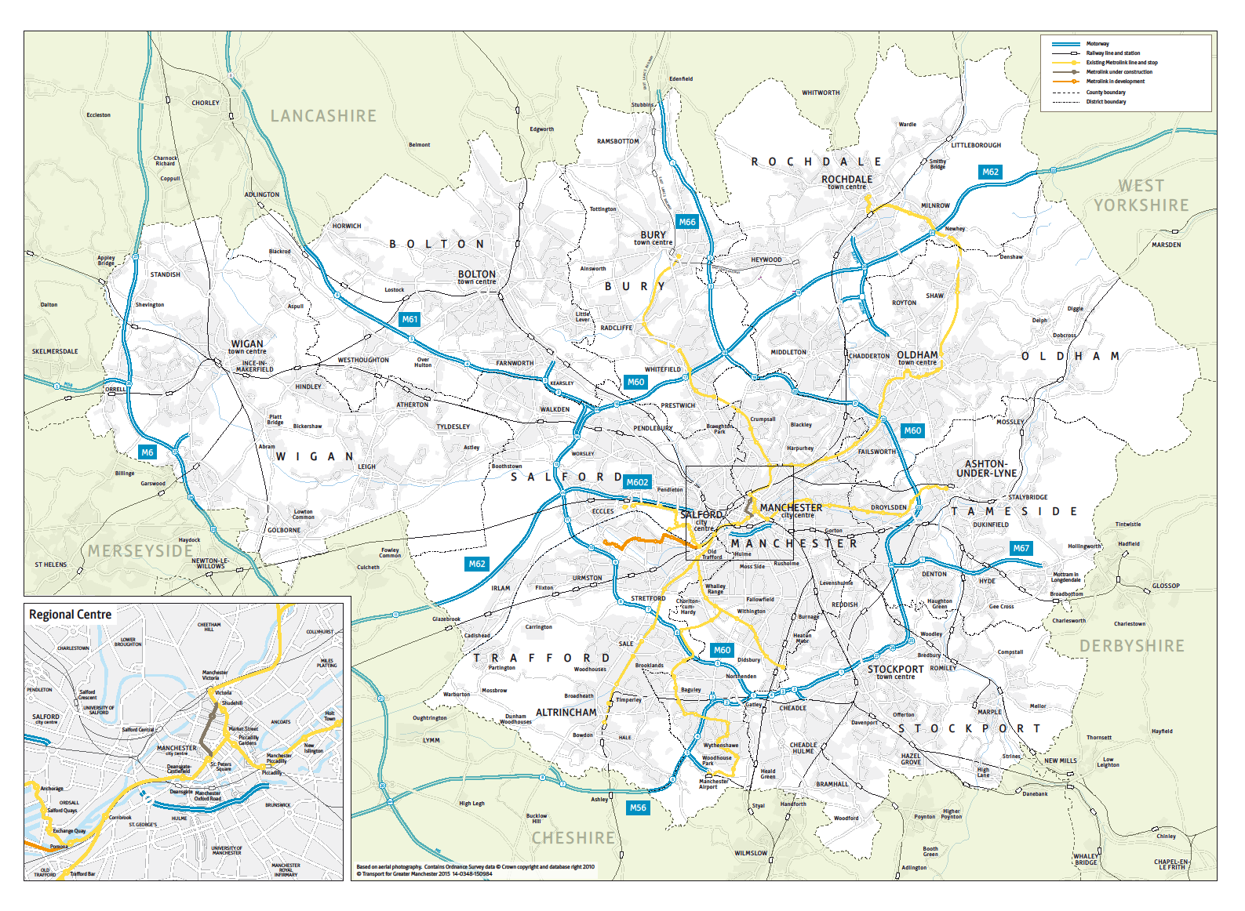
Greater Manchester

Slide 8

DISTRICTS
Bury
194,606
Rochdale
226,992
Bolton
298,903
Oldham
243,912
Wigan
334,110
Manchester
568,996
Salford
278,064
Tameside
232,753
Trafford
236,301
Stockport
297,107
Source: 2022 Mid-year population estimates, Office for National Statistics (ONS)

Slide 9




ECONOMY
2.91 million residents in 2022
+212,000 (8%) since 2012
1.3 million in employment in 2022
+129,000 (11%) since 2012
126,000 businesses in 2022
+33,000 (35%) since 2012
Over 116,000 enrolments at GM Higher Education institutions in 2020/21
Gross Value Added
BIGGER THAN
SLOVAKIA - £76.9bn
GREATER MANCHESTER
ECONOMY
£78.7bn
NORTHERN IRELAND ECONOMY
£45.7bn
WALES
ECONOMY £69.5bn
NORTH EAST ECONOMY
£56.5bn
BULGARIA - £53.2bn
LITHUANIA - £43.1bn
Sources: Mid-year population estimates, ONS; Annual Population Survey, ONS; UK Business Counts, ONS; Higher Education Statistics Agency; Regional gross value added (balanced) by industry, 2021, ONS; Gross Value Added, Eurostat, 2021
Notes:
LIS

Slide 10


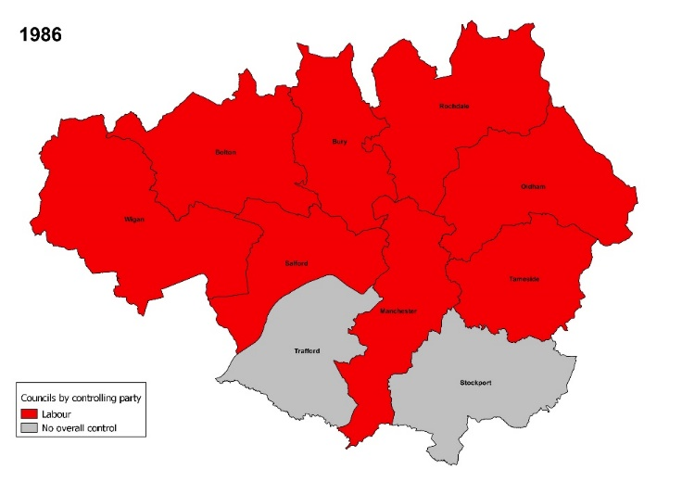
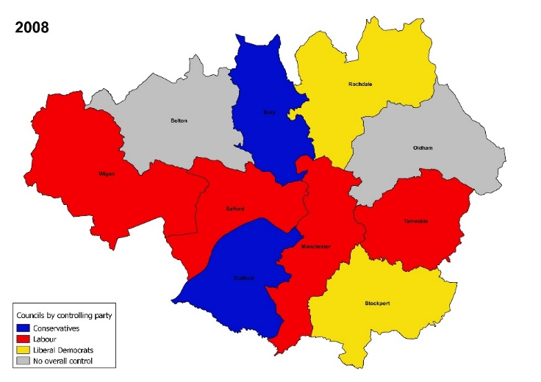
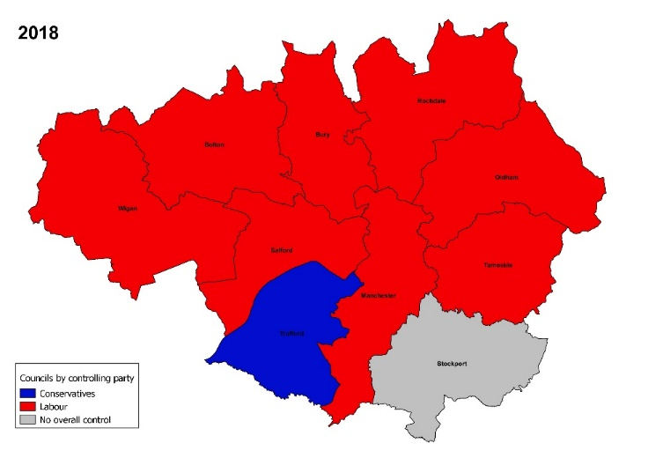
Political composition

Slide 11
The recent evolution of
Greater Manchester institutions

Slide 12










TIMELINE
‘Greater Manchester Strategy – Sharing the Vision’ published
Greater Manchester Council abolished
First Metrolink line opens
Marketing Manchester established
RDAs established
1986
1992
1993
1994
1995
1996
1997
1998
1999
2003
2006
City Pride Partnership created
MIDAS established
City Region Development Programme
Manchester Enterprises established
Association of Greater Manchester Authorities and GMPTA established

Slide 13














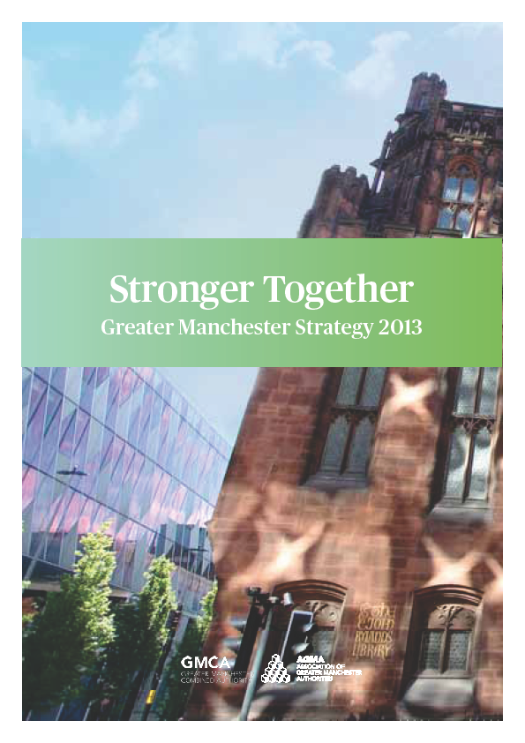
TIMELINE
Greater Manchester Multi Area Agreement
Transport referendum held (congestion charging)
Thematic
Commissions
established
Growth & Reform Deal
First mayoral election
GMCA & LEP
established
Growth Company established
Further
Devolution
announced
Sixth devolution deal
2008
2009
2010
2011
2012
2013
2014
2015
2016
2017
2018
2017
Spatial
Framework
Consultation
Statutory City Region Pilot
Devolution
Agreement
Fifth devolution deal
New Economy established
GM
City Deal
Publication
of the MIER and the first GM Strategy
Refreshed
GM Strategy
Health and
Social Care
MoU
New GM Strategy
TfGM established

Slide 14
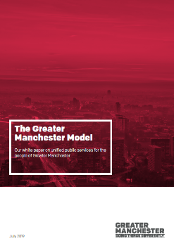

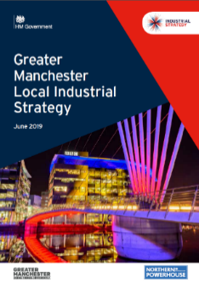
TIMELINE
Independent Prosperity Review
Unified Public Services White
Paper
Living with COVID Plan
Bus Franchising across Greater Manchester
Second mayoral election
2019
2020
2021
2023
2024
2025
COVID-19 pandemic
Third mayoral election
Integrated Settlement
Local Industrial Strategy
Seventh Devolution Deal
Independent Prosperity Review
One Year On

Slide 15
GMCA at the forefront of English ‘devolution’

Slide 16
Organisational evolution of GMCA
First piloted in 2009, launched in shadow form 2011
Framework provided by existing GM institutions, statutory and ‘bottom up’ – transport (inc. airport), ‘blue light’ services, inward investment, visitor promotion, employment, business support etc.
Built upon through unprecedented series of bespoke ‘deals’ negotiated with Conservative national governments, 2014-24
Institutionalised in 2017 with election of metro mayor, absorption of fire service and (subsequently) waste authority into single organisation
Driven by elected mayor and his/her cabinet, comprising the ten district council leaders and an appointed police commissioner, each leading on a functional portfolio; shared leadership model contrasts with London but used for other CAs
Serviced by district Chief Executives, who provide portfolio support, and officers of GMCA and other GM institutions (Growth Company, TfGM, Police)

Slide 17
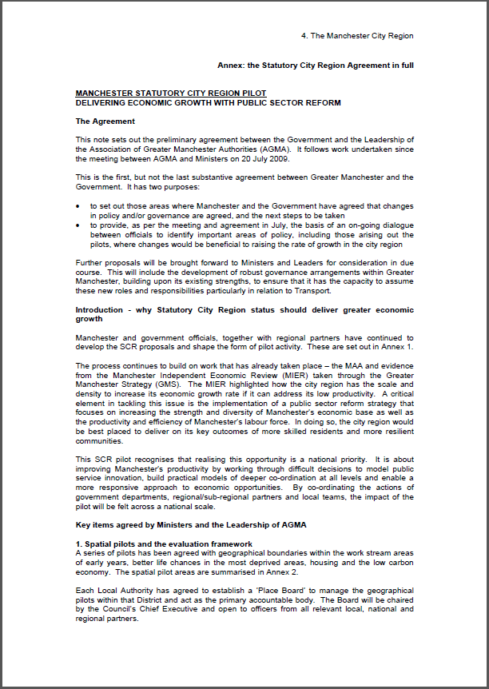
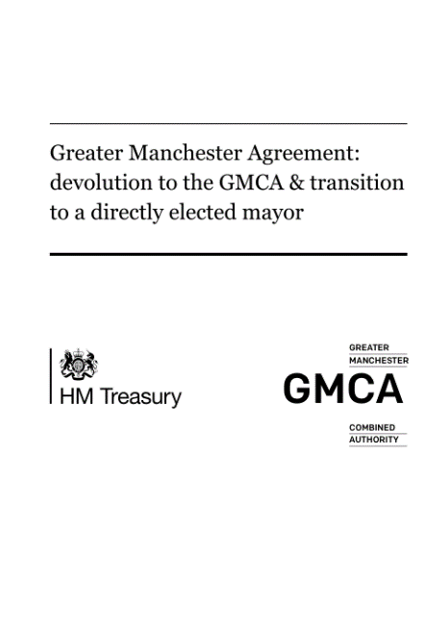
Devolution Deals
Deal 0: Agreed Dec 2009
Statutory City Region Pilot created, covering transport, total place public services, employment programmes, housing and planning, low carbon, inward investment and innovation, and post-16 skills.
Deal 1: Agreed Nov 2014
Agreement to have an elected mayor who will fulfil role of Police & Crime Commissioner. Powers cover transport, business support, employment & skills support, spatial planning, housing investment, earnback and governance reforms.
Deal 2: Agreed Feb 2015
Bringing together health & social care budgets – £6bn – to deliver better outcomes for GM
Followed up by agreement in late 2015 for a £450m Health and Social Care Transformation Fund.
Deal 3: Agreed July 2015
Included fundamental review of service for children, creation of a Greater Manchester Land Commission, transfer of Fire & Rescue responsibilities to the GM Mayor.

Slide 18
Devolution Deals
Deal 4: Agreed Nov 2015
Included further transport devolution (including looking at options for control of rail stations), social housing reform, and control over EU funding.
Deal 5: Agreed Mar 2016
Included establishment of GM Life Chances Fund, Criminal Justice Devolution, and piloting of 100% business rates retention.
Deal 6: Agreed Nov 2017
Included local industrial strategy pilot, homelessness funding, Transforming Cities Funding, post-16 education and training, and Mayoral capacity funding.

Slide 19
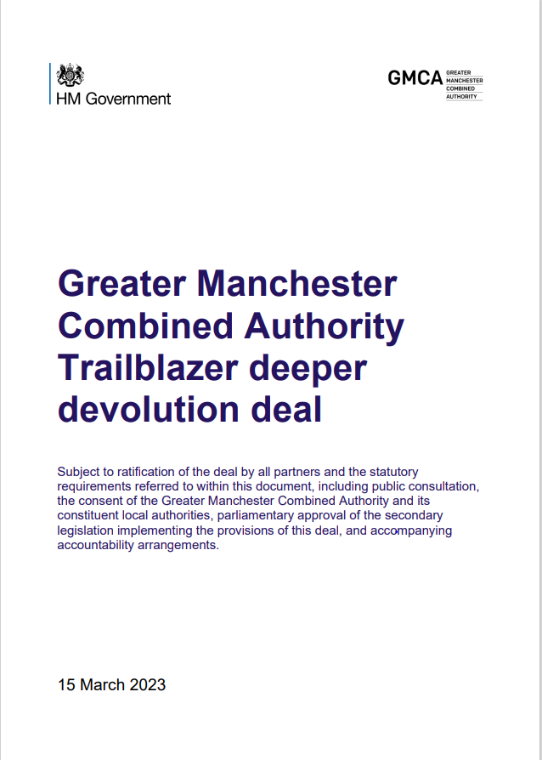
Trailblazer Deal
Deal 7: Agreed March 2023
Single Settlement
For the next Spending Review period (due to begin in 2025-26), Government will agree a Single Funding Settlement with GMCA. It will include funding for Local growth and place; Local transport; Housing and regeneration; Adult skills; and Retrofit/Net Zero. This will cover an entire Spending Review period, giving GM greater flexibility to plan and fund priorities over the long term, and replace multiple grant agreements and bespoke reporting requirements with a single streamlined accountability framework.
Fiscal devolution
Authorities in GM will be allowed to retain 100% of their Business Rates for 10 years. The Government will also work with GM to designate a number of specific growth zones, within which 100% of Business Rates growth will be retained for 25 years.
Governance and accountability
There are a series of measures designed to strengthen the GMCA Overview and Scrutiny Committee, including commitments that the GMCA Chair and other Members will attend Council meetings, public question times, and a new scrutiny session for GM Members of Parliament to be held in public four times a year.

Slide 20
Trailblazer Deal
Deal 7: Agreed March 2023
Skills and employment
A new Partnership for post-16 Technical and Education and Skills will provide oversight of post 16 technical education and skills. Non-apprenticeship adult skills functions and grant funding for post-19 will be devolved in the next Spending Review period, and several immediate flexibilities given. And Government has committed to a co-design approach to all future contracted employment support programmes, with an assumption of a delegated delivery model.
Transport
A new Rail Partnership with Great British Railways (GBR) will support the integration of Rail into the Bee Network by 2030, inc. through full fares and ticketing integration across bus, Metrolink, and Rail. Government will also work with GM on the legal powers needed to effectively tackle anti-social behaviour and fare evasion on buses.
Housing and regeneration
£150m of Brownfield funding will be devolved over the next three years to deliver 7,000 homes. GMCA will gain new, strategic oversight of the Affordable Homes Programme and the existing Strategic Place Partnership with Homes England will be strengthened. A Housing Quality Pathfinder will provide funding and powers to support GM authorities to tackle poor quality private rented sector properties.

Slide 21
Trailblazer Deal
Deal 7: Agreed March 2023
Economy, growth and culture
The Deal establishes a new Strategic Innovation Partnership, Strategic Productivity Partnership (on business support), and Strategic Cultural Partnership. There are also a range of commitments to support between GM-Government joint-working on trade, investment and exports.
Net zero and environment
Government will pilot devolving net zero funding (inc. buildings retrofit) to GMCA from 2025 onwards, as part of GMCA’s single department-style settlement. The Mayor of Greater Manchester will be appointed as the responsible authority to develop the Local Nature Recovery Strategy (LNRS) for GM, and Government and GM will work on a range of net zero, nature recovery and climate change adaptation strategies, regulations, pilots and policies.
Public services
New funding streams relating to prevention and/or multiple disadvantage will be considered for inclusion as part of the single settlement. Government will also work with GM to review the secondary legislation underpinning pooled budgets (Section 75).
Data and digital
A new Data Partnership, alongside a review of options (legislative or otherwise), will support better sharing of data between Government and GM bodies. A new Digital Infrastructure Leadership Group will also be established.
Resilience
Government will work with GMCA to pilot and test key aspects of the UK Government Resilience Framework.

Slide 22
Evidence, narrative and strategy

Slide 23

Manchester Independent Economic Review (MIER) 2009
The Case for Agglomeration
Innovation, Trade & Connectivity
Labour Markets, Skills & Talent
Daresbury Campus Review
Sustainable Communities
Inward & Indigenous Investment

Slide 24


Slide 25

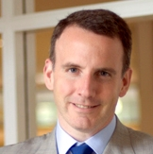
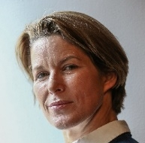



Greater Manchester Independent Prosperity Review Panel
  Intensive nine-month process to update Greater Manchester’s economic evidence-base, led by a panel of leading economic experts
  The Review Panel was responsible for:
    Assessing progress against the MIER and identifying lessons learnt
    Reviewing GM’s evidence base and current policy response, identifying key gaps
    Commissioning new, ground-breaking research into priority areas
    Making recommendations for the GM Local Industrial Strategy
Diane Coyle (Chair) Bennett Professor of Public Policy, University of Cambridge | Professor Ed Glaeser Professor of Economics at Harvard University
Stephanie Flanders Head of Bloomberg Economics | Professor Henry Overman Professor of Economic Geography at the London School of Economics
Professor Mariana Mazzucato Professor in the Economics of Innovation at University College London | Darra Singh Government & Public Sector Lead at Ernst & Young

Slide 26
Consistent, stable leadership

Slide 27
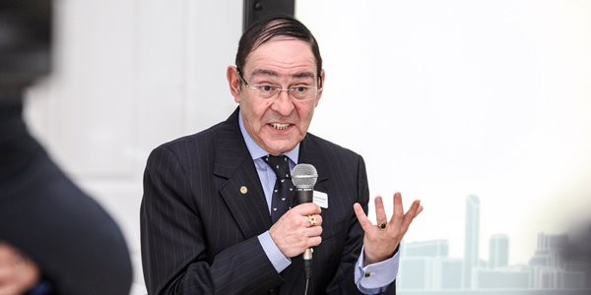
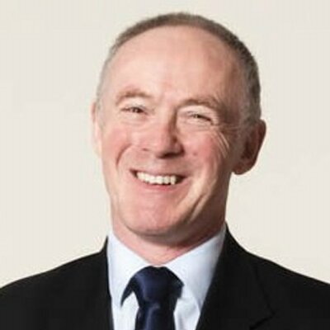
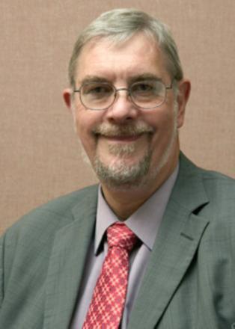
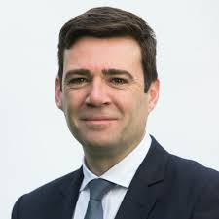

Slide 28
GMCA today

Slide 29
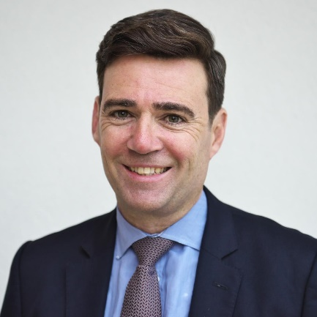

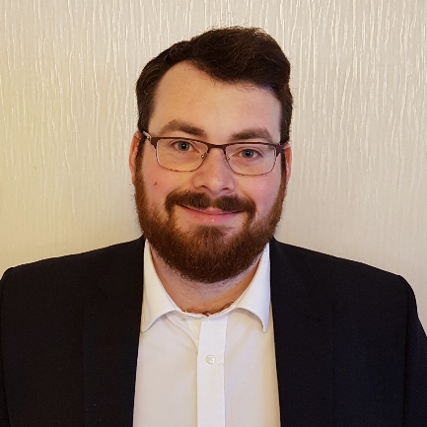


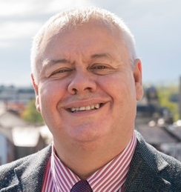

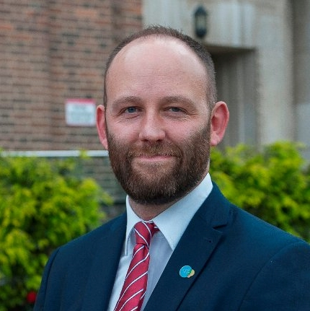
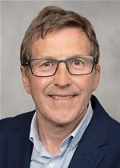

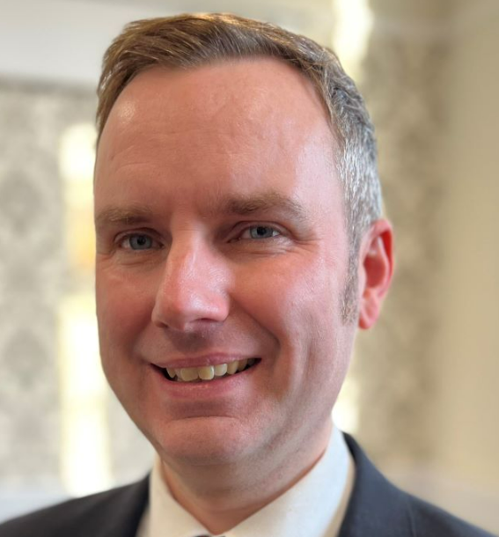
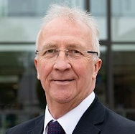
CURRENT GMCA POLITICAL LEADERSHIP
Andy Burnham
Mayor of Greater Manchester
Cllr Nick Peel
Bolton Council
Cllr Eamonn O’Brien
Bury Council
Cllr Bev Craig
Manchester City Council
Cllr Arooj Shah
Oldham Council
Cllr Neil Emmott
Rochdale Council
Kate Green
Deputy Mayor for Police, Fire & Crime
Mayor Paul Dennett
Deputy Mayor & Salford City Council
Cllr Mark Hunter
Stockport Council
Cllr Eleanor Wills
Tameside Council
Cllr Tom Ross
Trafford Council
Cllr David Molyneux
Wigan Council

Slide 30












FUNCTIONS
Police & Crime
Planning & Housing
Environment & Low Carbon
Transport
Fire & Rescue
Health & Care
Business Support
Skills & Adult Education
Employment Support
Investment
Waste & Recycling
Culture

Slide 31
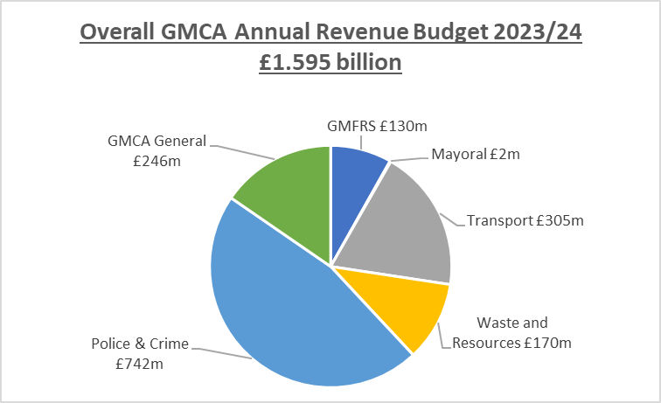

Slide 32
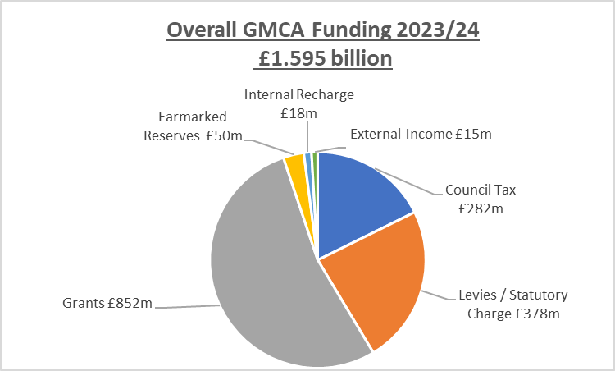

Slide 33
The secrets of Greater Manchester’s success
Clear focus on improving economic performance but not ignoring distributional issues (spatial, social)
Investment in the evidence base for policy
Development of a clear, persuasive narrative that can achieve support at local and national level
Consistency of local political and executive leadership
Asset-based, not sector-based strategy
Pragmatism; intergovernmental and political – ‘place first, not (political) party first’

Slide 34
