Slide 1
Housing market trends
Amsterdam
Housing Department
Dr. Kees Dignum

Slide 2
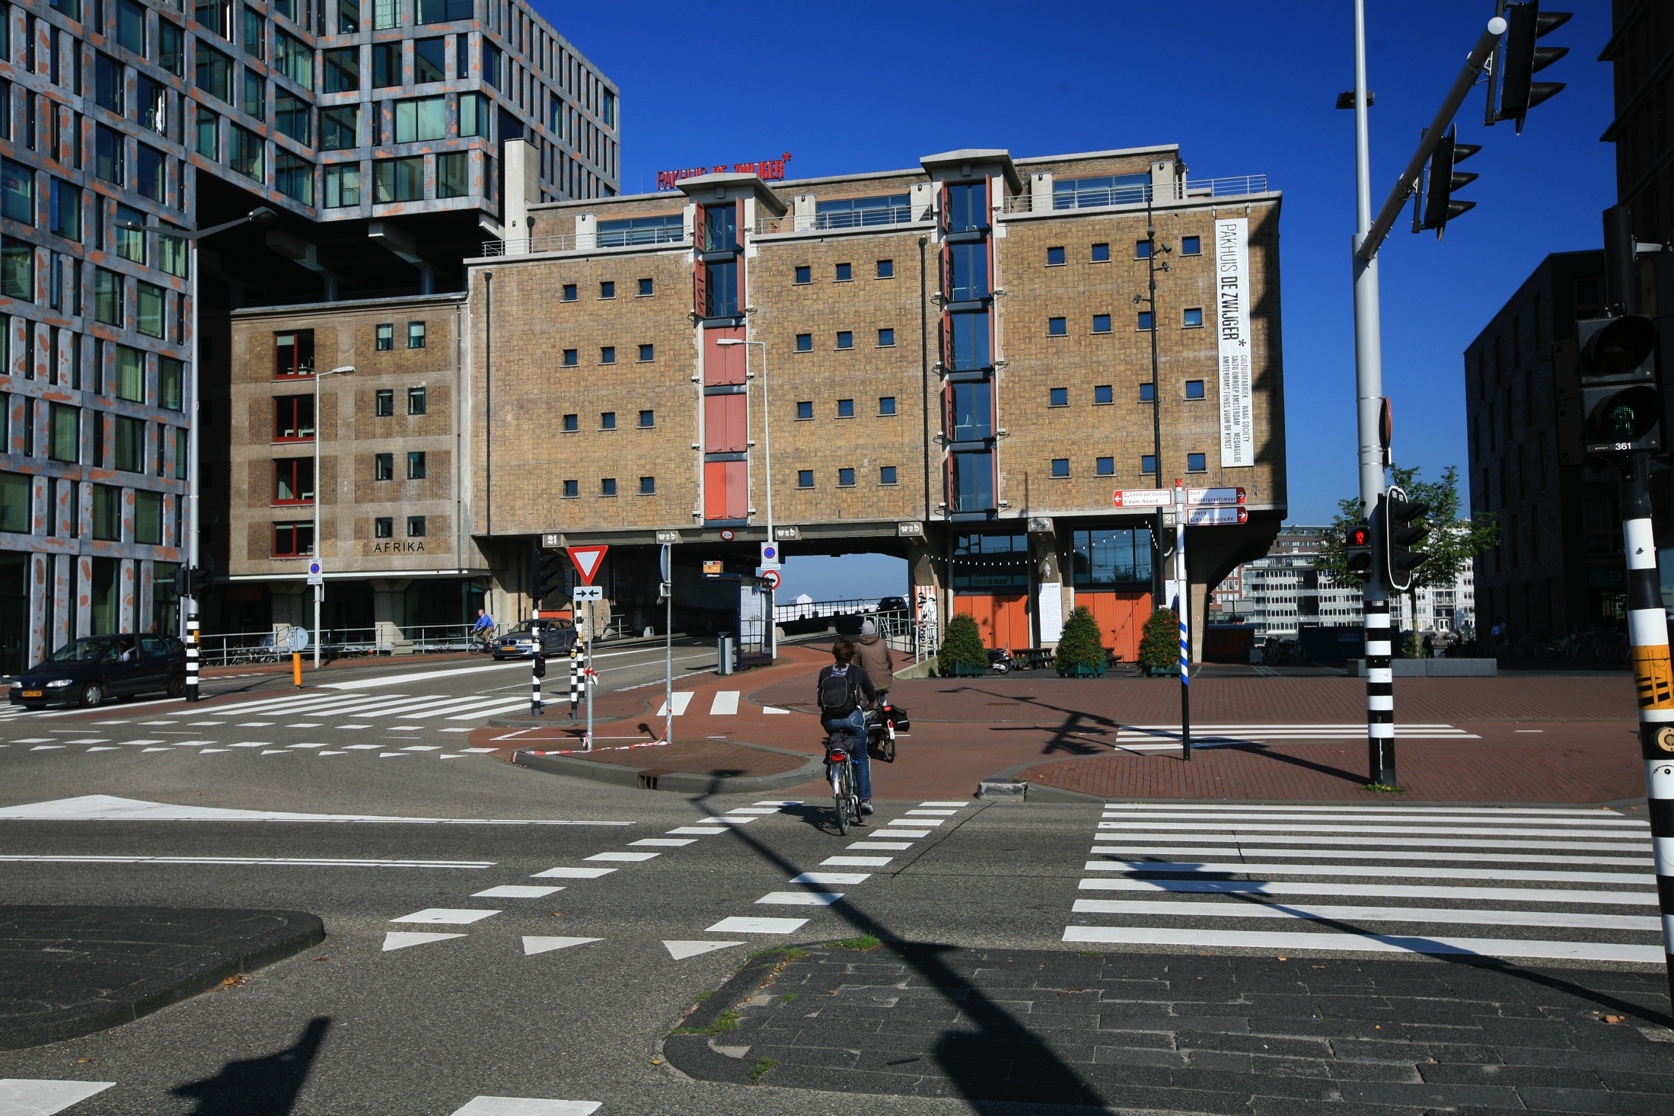

Slide 3
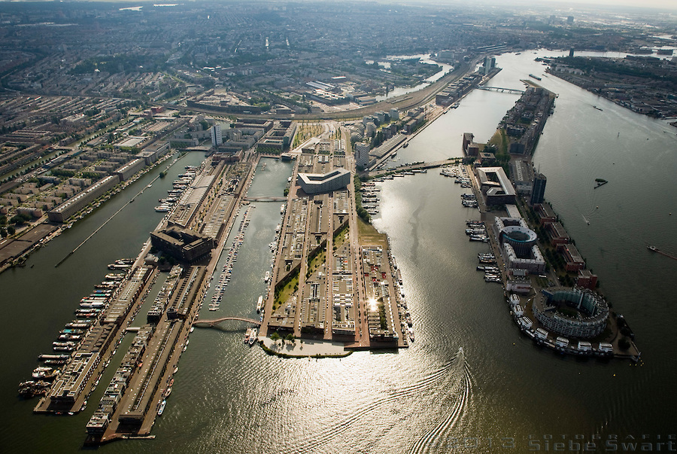
Big Urban Developments, reclaming the harbour area, mixed use

Slide 4
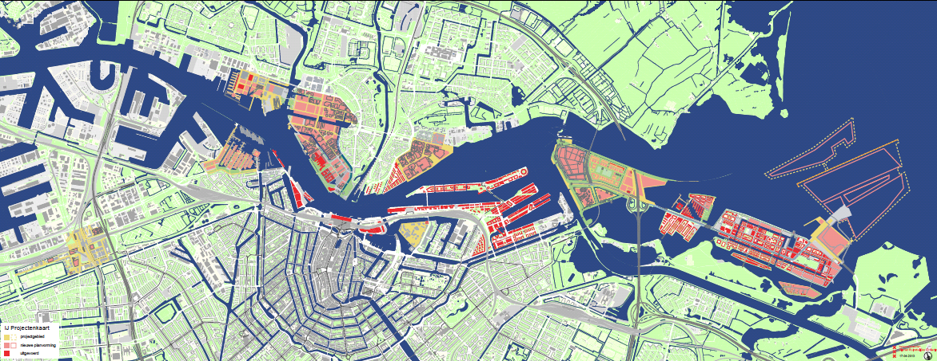
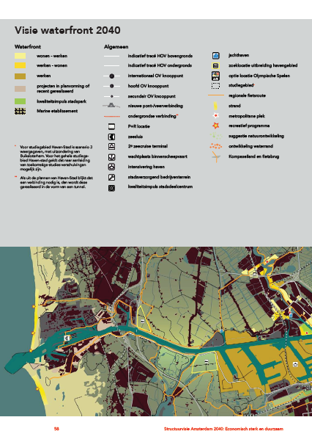
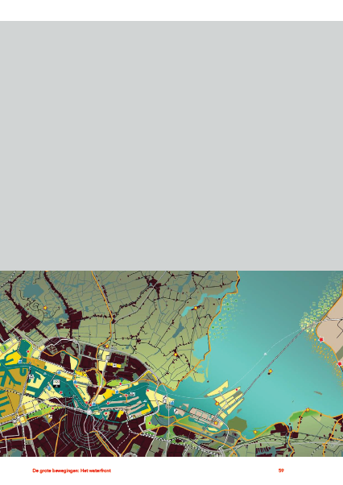
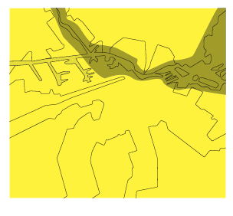
Waterfront ontwikkeling rond het IJ
Waterfront development
Notes:
4

Slide 5
Your questions
How is social housing organized in the Netherlands?
Situation of social housing today?
Causes and consequenses of gentrification
Measures to fight gentrification
Demographic presure
Tension between quantity – quality – affordability
Governance

Slide 6
Old and new trends / patterns
Repairing gaps after massive suburbanization 1960-1985
After the economic crisis (2009-2013)
Increasing supply deficit, despite high building program
Steep price trend since the crisis
Extreme demography
Sharper duality between protected social sector and free market
Mixing of functions (residential/economical) puts extra pressure
Difficulties to measure the influence of new capital and to put restrictions on them
Building for small households, what about families?
Mixed neighbourhoods: how to retain this policy?

Slide 7
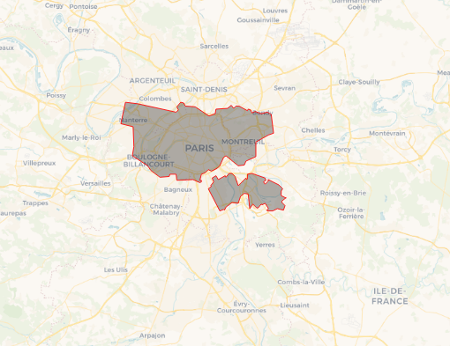
Amsterdam, small but attractive

Slide 8
Amsterdam Metropolitan Region
2,5 million now; 2,9 million in 2040

Slide 9
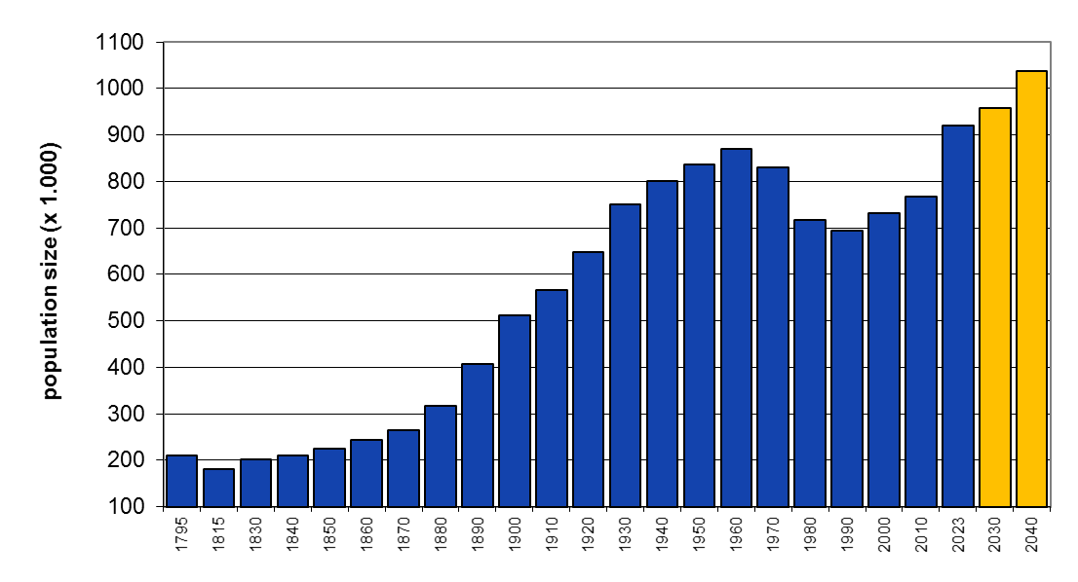
Repairing the demographic gap
1959: 872+

Slide 10
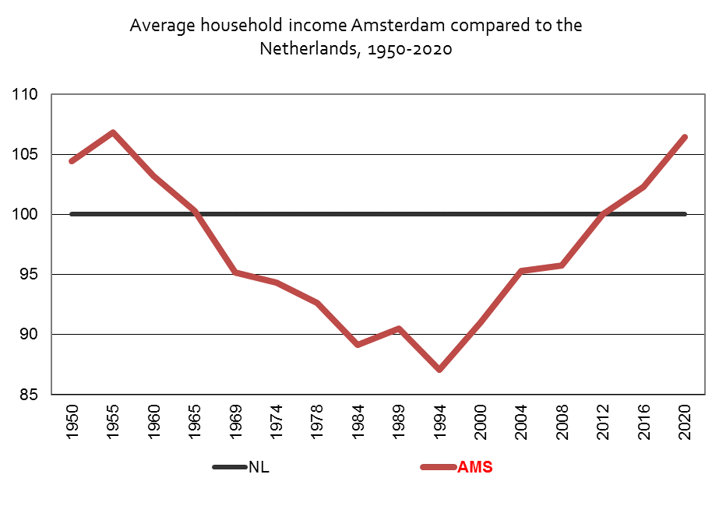
Repairing the income gap

Slide 11
Stages of urban development
1900-1920: Responsibility: new housing organizations, building for poor
1920-1940: Ambitious new concepts, huge production
1940-1950: War and recovery
1950-1965: Creating space for overpopulated city
1965-1980: Income growth, car-ownership, suburbanization: declining city
1980-1990: Urban renewal: fighting the decline of prewar Amsterdam
1990-2000: Competing the suburban attraction
2000-2023: Finding new/old space for urbanization, neo-liberal wave
2023-2030: Densification, gentrification and responsibility for lower and middle incomes

Slide 12
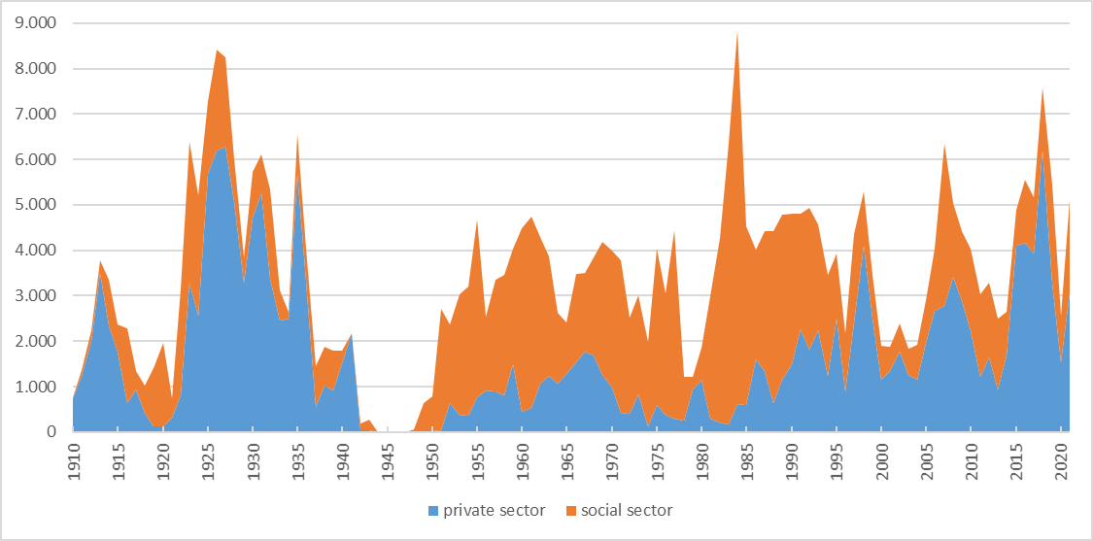
Long tradition of building social housing

Slide 13
Quality is at stake in every stage
Quality of dwellings and neigbourhood
Availability / Accessibility
Price

Slide 14
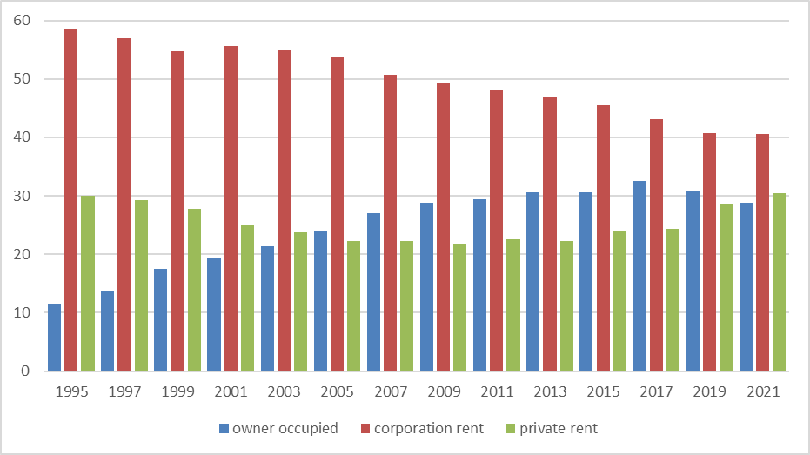
Creating a diverse housing supply

Slide 15
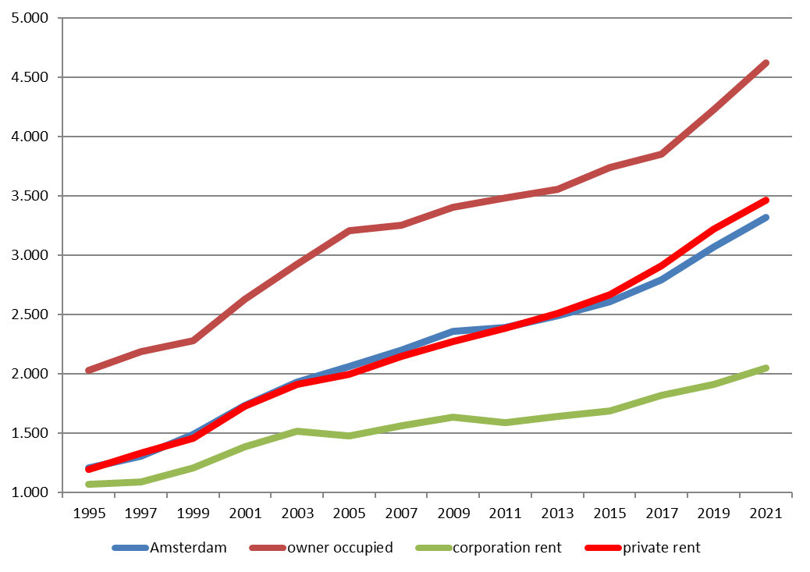
Three sectors, three income groups

Slide 16
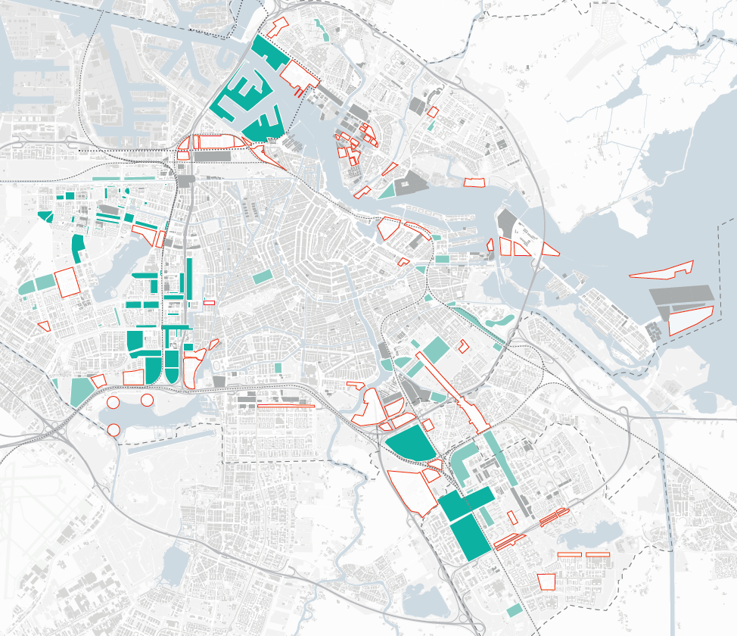
Densification, building for gentrifiers and ‘normal people’
2017-2025

Slide 17
Housing supply deficit: scarcity
Tension regions
Some deficit is good for vitality
3,5% deficit is a national problem
5,4% in MRA will shrink to 3,4% in 2030.
Ambituous bulding program
  Yearly 17.500 Amsterdam Metropolitan Area
Source: Staat van de woningmarkt 2021

Slide 18
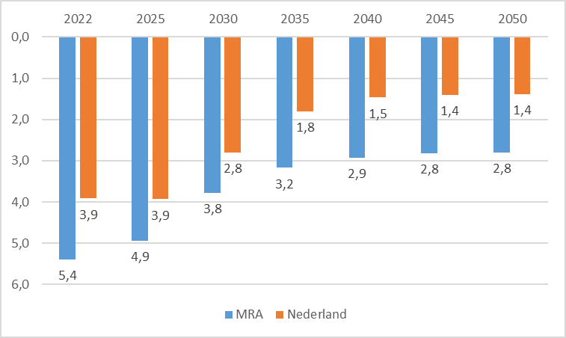
Housing supply deficit: scarcity

Slide 19
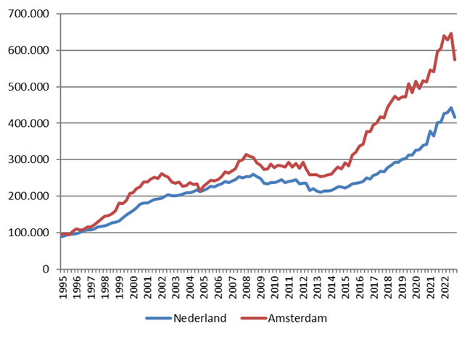
Extreme price trend in Amsterdam
Average prices (€) in owner occupied sector
Source: CBS

Slide 20
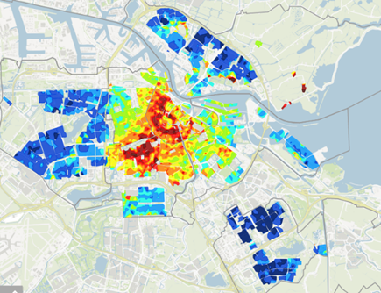
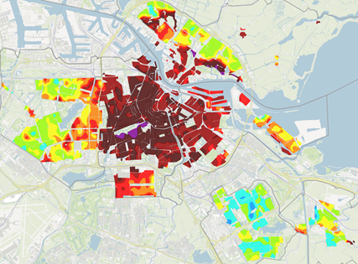
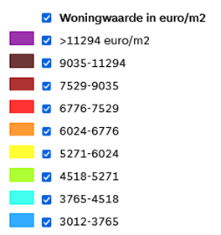
Extreme price trend in Amsterdam
Average square meter prices (€) in owner occupied sector 2015 and 2022
Source: Maps.amsterdam.nl

Slide 21
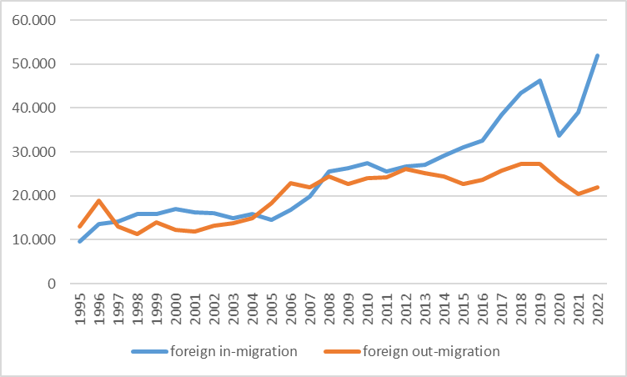
Extreme demographic trends
Foreign migration
Source: O&S / CBS

Slide 22
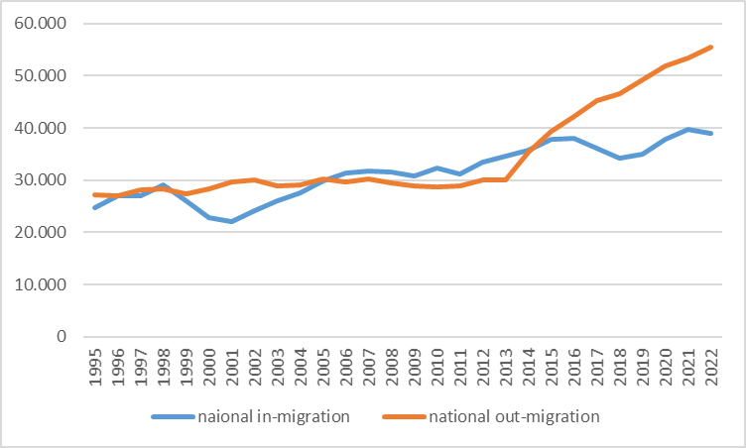
Extreme demographic trends
National migration
Source: O&S/CBS

Slide 23
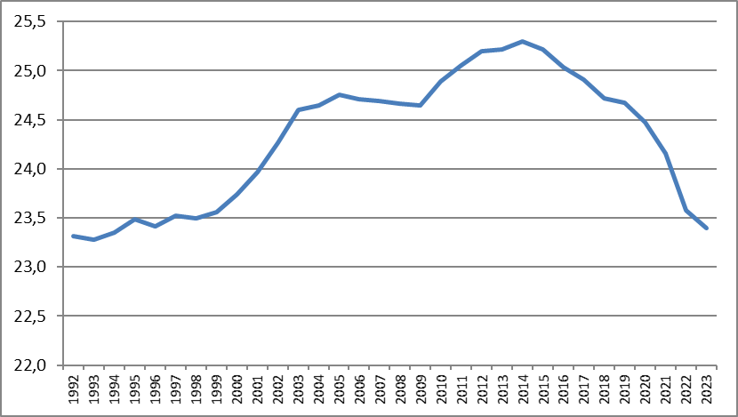
Rapid decrease of family households
Source: O&S

Slide 24
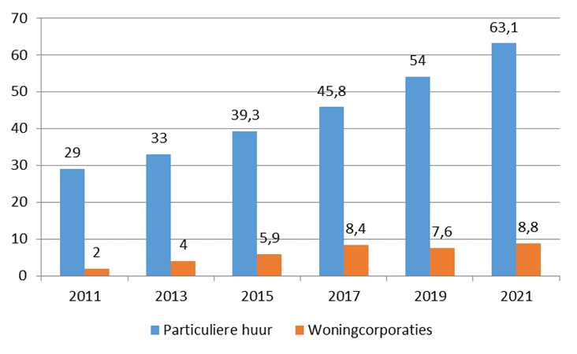
2/3 private rental sector = free market rent
9/10 corporation sector = regulated rent

Slide 25
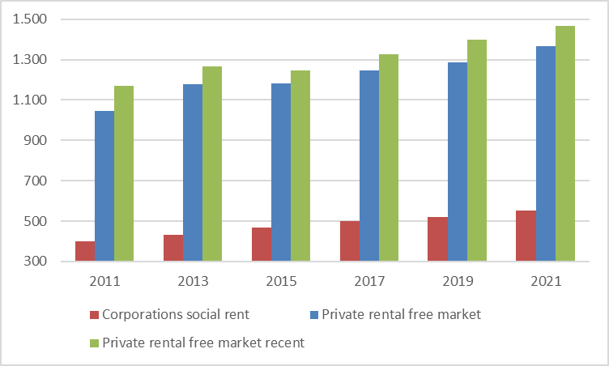
Price rise in free market rent

Slide 26
Three sectors, three income groups?
Two price segments, two income groups!

Slide 27
Long ‘waiting’ time in social rental
Average years of subscription on the supply-website of social housing
at the moment of accepting a dwelling

Slide 28
Conclusions about scarcity
  Housing deficit is huge and will not diminish
  Strong urban economy: Cultural, Consumption/Recreation international workers
  Huge foreign in-migration and strong trend in non-residential use of dwellings like holiday rental
  Intensifying functional mix (residential and economical) central AMS
  Housing market pressure after the crisis spreading from Amsterdam to surrounding region (MRA); families in search for affordable space, chain migration.
  Also inside Amsterdam dispersion of extreme square meter prices.
  Housing and economy in a virtuous/vicious relationship
  Counterbalancing market forces
  For regulation national government has the key: rent control, tourism

Slide 29
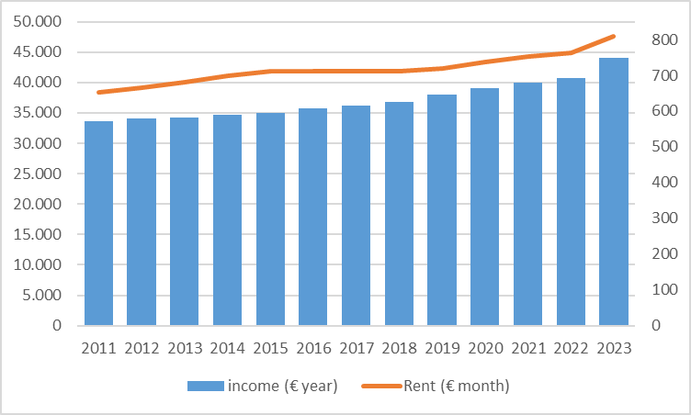
Governance: eligibility
  Who can enter to social rent?
  Maximum income € 44.035 and maximum rent € 808,06 (2023)

Slide 30


Toward London?
Leaving the Vienna path
2008-
2010
2012-2017
State aid rule (SGEI): rent and income threshold from 2011 onwards
Landlord Levy for corporations and invitation to buy the social housing stock

Slide 31


Crisis -> Public Housing
Continuing liberal wave
2017-
2021
2022-
?
No real changes of the liberal line
Back to State regulation, of social rent and extending regulation to mid-level rents

Slide 32
Governance: Rent regulations

Slide 33
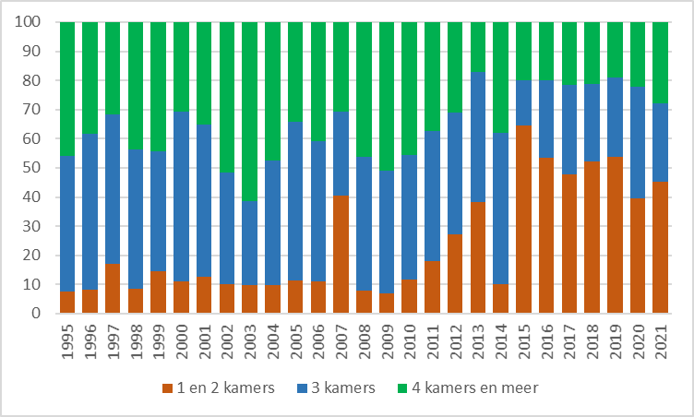
New built: small dwellings
Average building 7,500 per year (2022-2030)
Since 2015 Amsterdam builds 40-50% 1 en 2-room dwellings
Bron: O&S

Slide 34
Governance
  Dependancy of national political waves
  Using the fact that Amsterdam owns 80% of the land
  Using the fact that housing corporations are strong partners to municipality
    Limited sale
    Limited rent conversion
    Builing new social housing
    Sustainability program
    Program for housing vulnerable groups
    Fighting segregation trend
  Creating local legislations
  Limitations to holiday rental
  Protection against buy to let

Slide 35
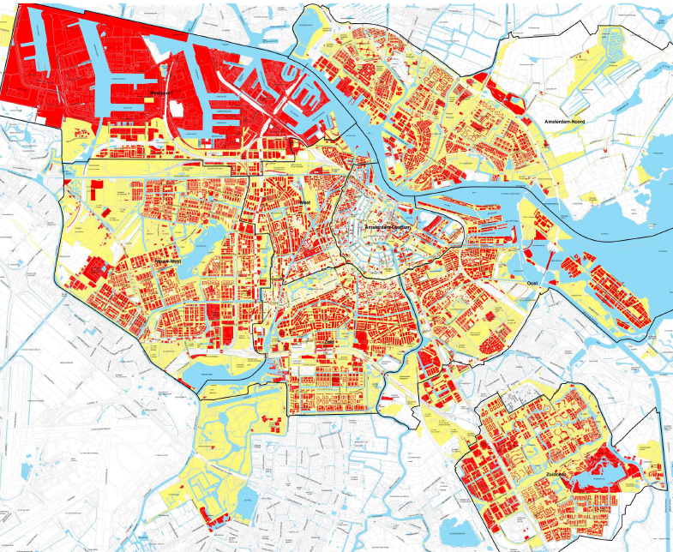
Legenda
Freehold
Land owned by Amsterdam:
Public space
Ground lease
Public land lease system since 1896
230.000 contracts, € 4,5 billion value, + € 200 mln each year
Notes:
As much of the growth of Amsterdam took place since 1900, and almost all land development after 1900 was with ground lease, the current owner map of Amsterdam looks like this. 80% of the land within the borders of the city is owned by the city. Over 50% of that land is leased. About 60% of all residential property is build on ground lease.

Slide 36
Ground lease and equalization
80% of land ownership belongs to City of Amsterdam. The majority is leased out.
Ground lease means dwelling or working on city-owned land, in accordance with zoning/development plan (bestemmingsplan).
Payment of lease is called canon, which account for a yearly income of roughly 100 million euros total. Designed for the (re)development of the city.
Why have a ground lease system:
    Increased value of land benefits the community
    Prevention of land speculation
    Important tool in regulation of development in public interest and controlling development of the city as a whole
Estimated 290.000 ground lease contracts
- 66% dwelling;
- 22% housing associations;
- 12% remaining (commercial, social/civil, mixed)

Slide 37
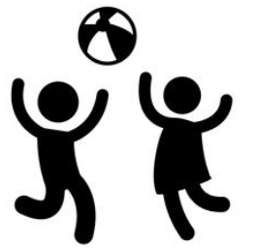
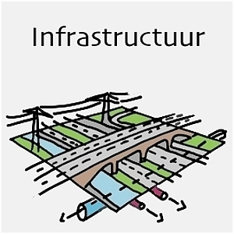

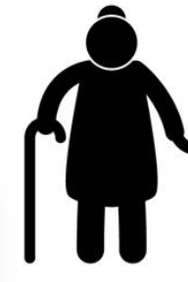
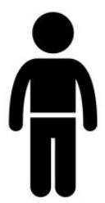
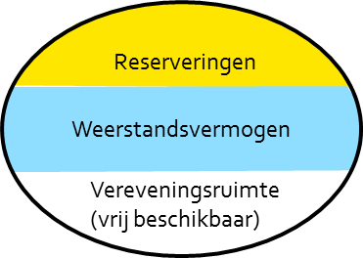
Equalization fund
uitnames algemene middelen
grondopbrengsten
Reserve
Grondexploitaties
winstneming
Voorzieningen
(plannen met een tekort)
grondkosten
Notes:
Uitleg kassaldo en reserves

