Slide 1
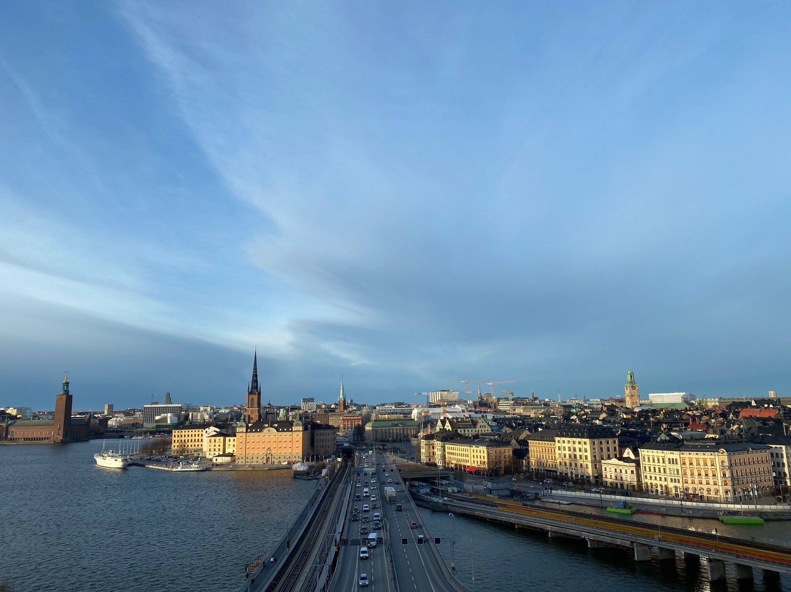
The relation between the state and the local and regional level;
Helena Linde
Senior Legal Advisor, Department of Law, SALAR

Slide 2
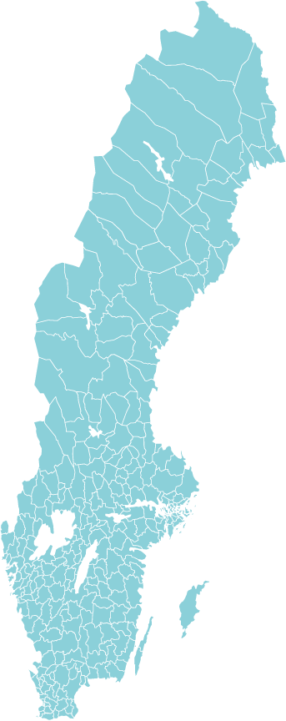
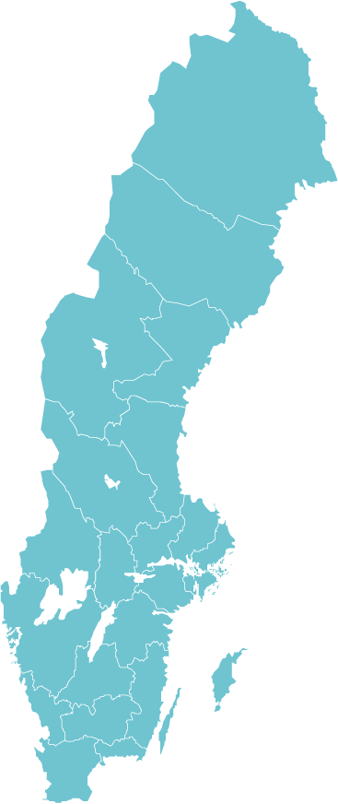
Our members
SALAR representing
290 Municipalities
21 County Councils/Regions
A prosperous Sweden is created locally

Slide 3
The political organization of our members
The Congress elects board and chairman
The Congress draws up the guidelines for SALAR’s work
451 congress delegates
The board leads the political work between congresses
Preparatory bodys
Notes:
SALAR's executive decision-making body is the Congress, which is composed on the basis of the general municipal and regional election results. The Congress representatives consist of municipal and regional politicians from the whole country. The Congress, which meets every four years, decides the direction of SALAR's work and appoints its board and chairman.
Between congresses, the board is in charge of the policy work. The board’s working committee is responsible for, among other things, talks with the state, parliamentary committees, and interest organisations. SALAR's political organisation also includes drafting bodies and delegations for various areas that prepare cases for the board. There are about 250 political appointments within SALAR.

Slide 4
Working on behalf of our members
safeguards members’ interests, nationally and internationally.
provides with networks for information exchange.
offers members service and advice.
Notes:
SALAR is a member organisation for Sweden’s municipalities and regions. All municipalities and regions are members. SALAR works on behalf of our members, with local and regional democracy as a starting point. Our main mission is to develop municipal self-governance with sufficient scope for action and strong civic support
> We actively safeguard members’ interests, nationally and internationally.
> We have a network for information exchange and offer members service and advice.

Slide 5
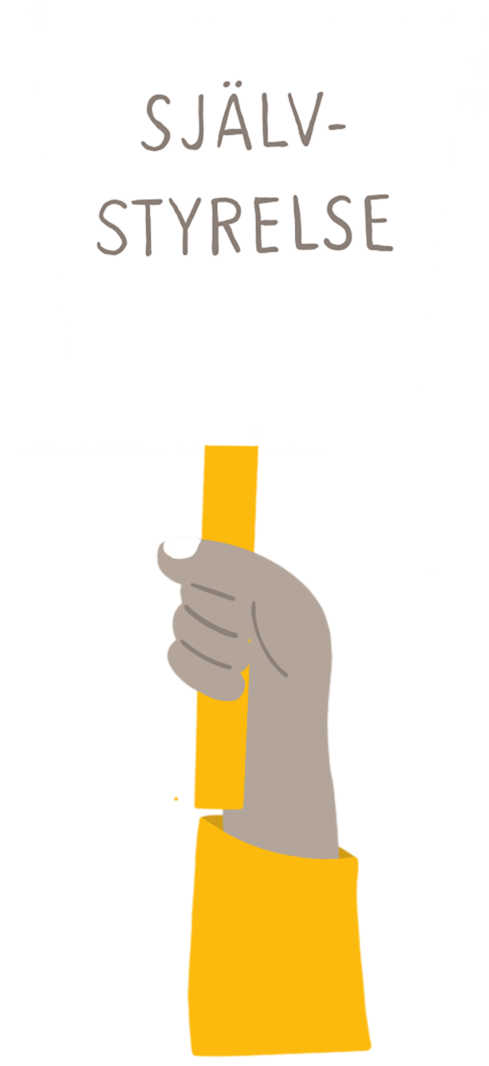
Knowledge organization of welfare
Employer organization
Actively safeguards members’ interests, nationally and internationally
Venue
Notes:
Venue – mötesplats

Slide 6
Three Democratic Levels
Notes:
The Public sector in Sweden is organized in three different levels: Local Municipalities, Regional County Councils and regions and the national level where we have the national parliament and the National government.
The decicis´ve bosies are in the locla level the municipal Council, at the regionala level the county council otr regional council and art the national level the parliament. We have a system with general elections every fourt year to the three levels.
The framework for what the municipalities and CC can and should do is decided in law by the parliament. The regional and locla bodies.
The municipalities are not in any way subordinated the regional councils. The different levels have different tasks.
The national Government Have regional bransches the county administrative boards which have tasks to effect certain national politics at the regional level, including some superision of the municipalities.

Slide 7
20 Regions
Largest: Norrbotten
(98 911 km²)
Smallest: Blekinge
(2 941 km²)
Median population: 300 000 inh.
Largest: Stockholm (2 371 774 inh.)
Smallest: Gotland
(59 642 inh.)
290 municipalities
Largest: Kiruna (19 447 km²)
Smallest: Sundbyberg
(9 km²)
Median population:
15.000 inh.
Largest: Stockholm
(972 647 inh.)
Smallest: Bjurholm
(2 432 inh.)

Slide 8
Division of responsibilities
Regions
compulsory
health and medical care, (regional development)
on voluntary basis
support to cultural activities, public transport
Municipalities
compulsory
social services, schools, spatial planning, health and environmental protection, refuse collection and waste disposal, rescue services, water and sewerage
on voluntary basis
recreation activities, culture, housing, energy, industrial facilities, public transport
Notes:
State
foreign policy, public order, higher education and research, labour market, social insurance and transfer payments

Slide 9
Welfare in a decentralized model
The Swedish municipalities and regions
Accounts for almost 25 percent of GDP
Employs about 25 percent of the Swedish workforce.
Accounts for about 70 percent of public consumption and half of public spending.
Right for taxation
Long tradition of local democracy and municipal self-government

Slide 10
Constitutional setting High Level of Independence
Local governments are mentioned in the first paragraph of the Constitution (the “instrument of Government”) together with the parliamentary form of government.
Decision making powers are exercised by elected assemblies.
Local governments have the right to levy taxes.
A general mandate: “Local governments are responsible for local and regional matters of public interest.”
Any restriction in local self-government should be proportional, that is, not exceeding what is necessary given the aim of the restriction.

Slide 11
Local self-government
"Local self-government is the core of democracy, which ensures that power is decentralized and controlled close to the people. It ensures that issues concerning people's everyday lives are decided close to the citizens concerned and by political assemblies of their own choosing”.
Notes:
”
” Det lokala självstyret är demokratins kärna, som ser till att makten är decentraliserad och styrd nära folket. Den ser till att frågor som rör människors vardag avgörs nära de medborgare som berörs och av politiska församlingar som de själva har valt. ”
(Ur styrelsens VP 2021)
Local self-government is a longstanding tradition in Sweden and of fundamental constitutional significance.
The principle of local self-government has been enshrined in the Constitution as an integral part of
democratic government in Sweden.
The European Charter of Local Self-Government.

Slide 12
Local authorities and self government
Elected assemblies
Obligations in law
Principle of proportionality
Local self-government requires
that municipalities and
county councils dispose of
financial resources
Tax equalisation
Local self-government defined as a principle whereby local
authorities themselves shall decide local and regional matters of public interest.
Notes:
Local authorities
The principles of democracy shall also be applied in local government.
Decision-making powers in local authorities are therefore exercised by
elected assemblies (IG 14:1).
Local self-government may be defined as a principle whereby local
authorities themselves shall decide local and regional matters of public
interest. The nature of these matters is laid down in law.
Other matters which local authorities are responsible for on the principle of local
self-government (IG 14:2) are also laid down in law.
Local self-government can be restricted but in such cases a principle
of proportionality is to be applied. This means that restrictions should not
exceed what is necessary with respect to the purpose of the restrictions
(IG 14:3). If there are different ways of attaining the same objectives, the
Riksdag should respect the principle of local self-government and
choose the manner of regulation which least affects local government
decision-making powers.
Local self-government presupposes that municipalities and county
councils dispose of financial resources. The right of local authorities to
raise taxes has therefore been considered so indispensable that it is
affirmed in the Constitution (IG 14:4).
The constitutionality of tax equalisation between local authorities has
previously been a matter of contention. As of 2010, the Instrument of
Government explicitly states that local authorities may be obliged in law
to contribute to the costs of other local authorities on condition that the
measure is necessary to achieve equitable financial preconditions in local
authorities (IG 14:5).

Slide 13
Arguments for local self-governance
Democracy
Citizens appoint and can demand responsibility from their political representatives.
Citizens are close to the decisions.
Elected representatives have an overview and can take a holistic view.
Efficency
Performance of tasks can be designed based on local conditions and wishes.
Different solutions provide opportunities for comparisons and learning.
Division of powers
Room for diversity and development

Slide 14
A democratic heritage
Long tradition of shared responsibility and decision-making
Parish division in the 11-1200s - parish meetings.
New church order in 1571 gives the parishes responsibility for public education and care for the poor.
Cities also have a large independent role - trade - public townhouses.
New municipal ordinance 1863 - the starting shot for our modern municipalities, from parishes to 2400 county municipalities, in addition to 88 city and 8 köping municipalities and the formation of county councils.
More and more data during the 20th century lead to the 1952 municipal mergers, 816 large municipalities.
1972-74 next reform, 277 municipalities - today 290.

Slide 15
Governance; the relation between the state and the local level
Legislation, ordinances and recommendations
National goals and strategies,
Financing
Supervision
Court control
Knowledge; best practice evidence based methods and comparisons between local governments
Evaluations
Notes:
All in all, the state has great opportunities to govern municipalities through
legislation, regulations and government regulations.
The new regulations usually entail extended obligations or requirements
Framework legislation
Often filled out and specified in detail by the authorities and courtsthe result
often more detailed regulation than intended
The right to tax is complemented by state subisdies
Government grants are an important source of income
Supervision has been given a more important role in management policy in recent times
decades. especially in the heavy welfare areas of school, social care and health care
In essence, supervision is an important state control instrument to ensure
that municipalities and county councils carry out their tasks in the manner stipulated
in laws, regulations and regulations.
Knowledge management has three main parts - knowledge support,
support for follow-up and analysis, and support for business development
Many of the knowledge support and follow-up systems
used nationally has also been developed in cooperation between the state and
SKL or individual county councils
health care, school and social care that most state authorities control
with knowledge. However, state knowledge management also exists
in areas such as crisis preparedness, the environment and urban planning activities.

Slide 16
The Swedish Agency for Public Management
Government governance - more comprehensive and detailed
Targeted government grants
Supervision and follow-up lead to increased administration
Detail control reduces the room for maneuver
Styrningen sträcker sig långt in i kommunernas och regionernas verksamheter
Styrningen riskerar att motverka nationell likvärdighet
Kommuner och regioner har olika förutsättningar att hantera statens styrning.

Slide 17
Challenges
State administration of education
State control has increased
More and more votes are being raised for increased state control / nationalization
Investigations on increased state governance / nationalization
Health care – a call for equivalence
”The same level of tax in all municipalities and regions ”

Slide 18
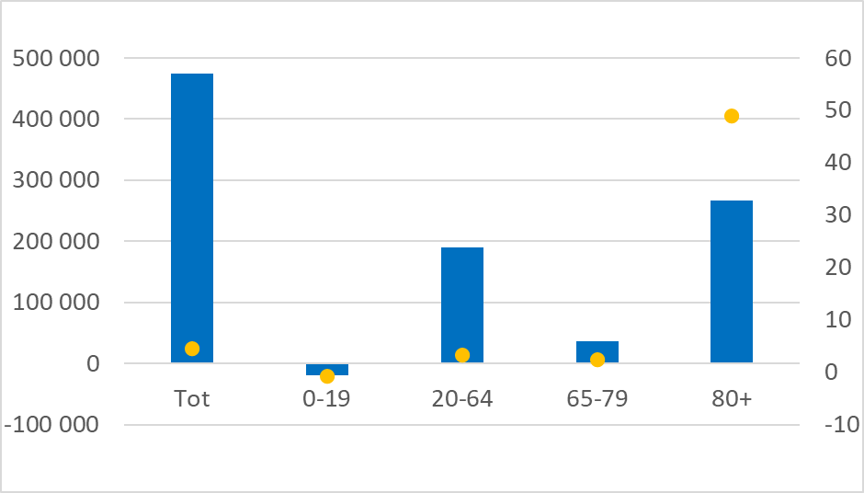
Change in demographics 2020-2030 SCB 2021
Notes:
Antal (stapel) resp procent.

Slide 19
Equalization in taxation
Danderyd would need 11%, Malmö 27% and Åsele 39% in municipal tax, without an equalization system.

Slide 20
The basics of equalization
Income equalization;
tax power, 95% state-funded ("state subsidy distribution system"). 85-95% compensation rate
Cost equalization
structural needs, inter-municipal, "needs equalization". 100% compensation rate
The structural contribution
"Permanent introduction grants" after the 2005 equalization reform, state-funded
Not included: property tax, municipal companies, development income

Slide 21
A balance of interaction and trust
Legislator
Authorities
Supervision
Courts

Slide 22
The legislative process
Public inquiery
Referral
Council on Legislation
Proposal
Parliament decisions
Notes:
The Government and the Government Offices
The Prime Minister and the other ministers
After each election the Speaker of the Riksdag (the Swedish Parliament) submits a proposal for a new Prime Minister. The Prime Minister is subsequently appointed by the Riksdag and tasked with forming a government. The Government, led by the Prime Minister, governs Sweden. The Government consists of the Prime Minister and a number of ministers, each with their own area of responsibility.
The Swedish Government at work
The Government governs Sweden and is the driving force in the process by which laws are created and amended, thereby influencing the development of society as a whole. However, the Government is accountable to the Riksdag and must have its support to be able to implement its policies.
The Government governs the country, which includes:
submitting legislative proposals to the Riksdag;
implementing decisions taken by the Riksdag;
exercising responsibility for the budget approved by the Riksdag;
representing Sweden in the EU;
entering into agreements with other states;
directing central government activities;
taking decisions in certain administrative matters not covered by other agencies.
The changes the Government wishes to make are set out in legislative proposals, or Government bills, which are then submitted to the Riksdag for approval. The Government is also responsible for drawing up a proposal for the central government budget.
When the Riksdag has taken its decision on a matter – for instance, a new law or the central government budget – it is up to the Government to implement the Riksdag's decision. If a new law gives citizens new rights or imposes new obligations, this also means new responsibilities for the government agency in charge of the area.
Collective decision-making
The Government takes joint decisions on all government business at government meetings, which are held once a week. At least five ministers must be present for the Government to be able to take a decision. Government decisions are the formal and final stage of a long decision-making process. A government decision is often preceded by several months of work at official level. Sometimes an item of business can involve the areas of responsibility of several ministers. In that case, it is prepared jointly by their staff. All ministers must be in agreement about the decision before it is taken up at the government meeting. Around 6 000 government decisions are taken every year. Information is available on regeringen.se both before and after a decision is taken.
The Government Offices at work
The Government Offices is a government agency that acts as the Government's staff and supports the Government in governing Sweden and realising its policies. The Government Offices include the Prime Minister's Office, the ministries and the Office for Administrative Affairs. The Government Offices has approximately 4 500 employees, some 200 of whom are political appointees. When there is a change of government, the political appointees resign while the non-politically recruited officials retain their positions.
The Prime Minister's Office leads and coordinates work in the Government Offices and is responsible for coordinating Swedish EU policy. The Prime Minister's Office is headed by the Prime Minister.
Each ministry is headed by a minister. In addition, a ministry may have other ministers with responsibility for specific portfolios. Every minister has a staff of politically appointed officials, for example state secretaries, political advisers and press secretaries.
Below ministerial level, a ministry's operations are directed by the ministers' immediate subordinate, the state secretary. Each ministry also has a director-general for administrative affairs responsible for ensuring that administrative matters that come before the Government are properly managed, and a director-general for legal affairs responsible for drafting legislative proposals and ordinances. Most government business is prepared by officials in the various departments and divisions within the ministries.
All ministries are involved in European Union (EU) work, and officials from every ministry represent Sweden in the EU and prepare issues ahead of EU meetings.
Sweden has around 100 missions abroad. Embassies, representations, delegations and consulates all fall into this category. Together with the approximately 400 honorary consulates, they make up Sweden's foreign representation.
Government agencies
Each ministry is responsible for a number of government agencies tasked with applying the laws and carrying out the activities decided on by the Riksdag and the Government. The Swedish Migration Board and the Swedish Tax Agency are examples of government agencies.
Every year the Government issues appropriation directions for the government agencies. These set out the objectives of the agencies' activities and how much money they have available to them. The Government therefore has quite substantial scope for directing the activities of government agencies, but it has no powers to interfere with how an agency applies the law or decides in a specific case. The government agencies take these decisions independently and report to the ministries. In many other countries, a minister has the power to intervene directly in an agency's day-to-day operations. This possibility does not exist in Sweden, as 'ministerial rule' is prohibited.
The Government is responsible for recruiting and appointing the heads (directors-general) of government agencies.
The budget process
The central government budget is a long process that begins more than a year before the start of the fiscal year concerned. The process begins in December when the Ministry of Finance presents forecasts for economic development to the Government. Discussions within the Government on the orientation of the central government budget are held in March. The overall focus for the coming years is set out in the Spring Fiscal Policy Bill, which is presented to the Riksdag in April.
Work continues in the ministries throughout the spring and summer, and the Government submits proposals for the central government budget for the coming year – the Budget Bill – to the Riksdag in September.
While the Riksdag is considering the Budget Bill, the ministries produce appropriation directions for the government agencies. The Government adopts the appropriation directions for the government agencies before the end of the calendar year.
The legislative process
The Riksdag decides whether to pass new legislation. The majority of legislative proposals are initiated by the Government. Around 200 bills are submitted to the Riksdag by the Government every year. Some of them propose entirely new legislation while others propose amendments to existing laws.
Inquiries and committees
Some of the issues handled by the Government are more complex than others. In such contexts, the Government may appoint an inquiry chair (one person) or a committee of inquiry (a group consisting of several people) to investigate the issue. The Government issues terms of reference setting out the mandate for the inquiry. Inquiry conclusions are gathered in a report which is published and made available to the public.
When the Government wants to introduce a new law, the process is usually as follows:
A government inquiry is appointed to investigate the issue. A committee or an individual is tasked with investigating the conditions for the measures the Government wants to introduce. The framework for the assignment is set out in terms of reference.
When the inquiry is complete the inquiry chair or committee drafts a report.
The report is sent for consultation to relevant government agencies, organisations, municipalities and other stakeholders, which can submit responses. If many of the bodies consulted take a negative view, the decision may be taken not to take the matter any further, or to attempt to find alternative solutions to those proposed by the inquiry.
The report is also sent to the Council on Legislation, which scrutinises the legal aspects.
The Government then drafts a proposal, in the form of a Government bill, to the Riksdag.
A parliamentary committee may submit views on the proposal (committee report).
The Riksdag votes on the bill. If passed, a new law can be promulgated in the Swedish Code of Statutes (SFS).
Some legislation affecting Sweden is enacted by the European Union. Certain laws adopted in the EU are directly applicable in Sweden without the need for the Riksdag to take a decision on the matter.
The Swedish social model
A democratic system with free elections
Sweden is a democracy with a parliamentary form of government, which means that all public power proceeds from the people. Laws are passed by the Riksdag, a parliament of 349 members elected by the people every four years. Following each election, the Speaker of the Riksdag proposes a new prime minister. The Prime Minister is then appointed by the Riksdag and tasked with forming a government. The Government, led by a prime minister, governs Sweden.
Formally, Sweden is a constitutional monarchy with King Carl XVI Gustaf as head of state. The monarch has a symbolic function as head of state and almost exclusively ceremonial duties.
When general elections are held in Sweden, the seven million people entitled to vote have an opportunity to influence who will represent the people in the Riksdag, county councils and municipalities.
To vote in the three elections, you must have turned 18 on election day at the latest. Various specific rules also apply:
To vote in the parliamentary election you must be a Swedish citizen and be, or have been, registered as a resident in Sweden.
To vote in municipal and county council elections you must be a Swedish citizen or:
citizen of an EU country, Iceland or Norway, and registered as a resident in the municipality/county council area concerned, or
citizen of another country not listed above, have been registered as a resident in Sweden for at least three consecutive years and be registered as a resident in the municipality/county council area concerned.
In addition to voting in elections, there are other ways to influence policy in Sweden. These include joining a political party, submitting views on inquiry reports and taking part in referendums.
Every five years there are also elections to the European Parliament, the only EU institution that is directly elected. Everyone who is a national of an EU Member State and is registered as resident in Sweden is entitled to vote in Sweden.
The Swedish administrative model – three levels
Sweden is governed at three levels: national, regional and local. In addition to these there is the European level.
National level The Riksdag, which has the power to pass legislation, represents the people at national level. The Government governs Sweden by executing decisions taken by the Riksdag and initiating new laws and legislative amendments. The Government is supported in this by the Government Offices and the government agencies.
Regional level Sweden is divided into 21 counties. Each county has a regional central government authority, the county administrative board. Some other government agencies also operate at regional and local level. There are 20 county councils. They are led by political assemblies elected by the people. The main task of county councils is health care. Counties and county councils cover the same geographical area (with one exception) so they are usually regarded jointly as the regional level. The highest decision-making bodies are the county council assemblies or regional councils. The county councils' activities are governed by the Local Government Act, but there is scope for autonomy, i.e. decisions in each municipality, county council or region are taken in the sector in question.
Local level Sweden has approximately 290 municipalities. The municipalities are responsible for the majority of public services in the area where you live. Their most important responsibilities include preschools, schools, social services and elderly care. The municipalities are governed by politicians elected by the people. The highest decision-making bodies are the municipal councils/city councils. The municipalities' activities are governed by the Local Government Act, but as at regional level there is some scope for autonomy.
European level Sweden is covered by the EU regulatory framework and participates in the process whereby new common rules are drafted and adopted. The Government represents Sweden in the Council of the European Union. The Prime Minister has overall responsibility for developing and coordinating Sweden's EU policy and represents Sweden in the European Council, which lays down guidelines for future cooperation.
The Swedish Constitution
The Constitution takes precedence over all other laws, and no other law may conflict with its provisions. Nor can it be amended as easily as other laws. Amendments require the Riksdag to take the same decision on two separate occasions. A parliamentary election must also have taken place between the two decisions.
The Constitution concerns Sweden's form of government, succession to the throne, freedom of expression and of the press, and other fundamental freedoms and rights.
The 1974 Instrument of Government embodies the basic political principles by which the state is governed. It defines and delimits the tasks of Government, establishes the basic rights and freedoms of the people of Sweden and prescribes the procedures for elections to the Riksdag.
The 1810 Act of Succession governs how the Swedish throne is inherited, that is, who becomes king or queen.
The 1949 Freedom of the Press Act contains provisions on freedom of the press and the right to access official documents.
The 1991 Fundamental Law on Freedom of Expression guarantees freedom of expression in radio, television, film and similar new media.
Human rights
Responsibility for ensuring that human rights are not violated rests with the Riksdag, the Government and the national, regional and local government administration as a whole. The Government's longterm goal is to ensure full respect for human rights in Sweden.
In Sweden, human rights are primarily safeguarded through the Constitution and other laws and ordinances. In addition, the European Convention for the Protection of Human Rights and Fundamental Freedoms has applied as law in Sweden since 1995. There are also other international intergovernmental agreements establishing human rights.
The Government's efforts to promote and protect human rights permeate both national policy and all aspects of foreign policy. Central government, municipalities and county councils must:
ensure respect for the fundamental freedoms, e.g. freedom of expression, freedom of information and freedom of assembly;
protect people from violations such as torture and arbitrary detention;
fulfil basic needs, such as housing and education;
combat discrimination of persons on grounds of gender, ethnicity, religion or other belief, disability, sexual orientation, age or transgender identity or expression.
Gender equality
Sweden has a long tradition of work for gender equality. Gender equality means that women and men enjoy the same rights and opportunities in all areas of life, for example equal opportunities on the labour market, shared responsibility for the home and children and economic equality. One important date in this respect was 1921, when women gained the right to vote. Many reforms and laws have been introduced since that date.
Power and influence
The proportion of women on the Swedish labour market has increased rapidly since the mid-1960s, and today women work to almost the same extent as men. But the balance of power and influence between women and men still varies between different sectors of society. Politics is one of the most gender-equal sectors. The proportion of women and men in the Riksdag is 45 per cent and 55 per cent respectively. There are fewer women in leading positions in other areas, such as science, culture, mass media, the Church of Sweden and business. Despite certain changes in recent years, the business sector is the most heavily male-dominated.
Public access
The principle of public access means that, as far as possible, the activities of government agencies, the Riksdag and local government decision-making bodies should be open. To guarantee transparency in these activities, the principle of public access to official documents has been enshrined in one of the fundamental laws, the Freedom of the Press Act.
The principle of public access entitles the general public to access official documents. Documents that are received or sent out by the Government Offices and other government agencies, e.g. letters, decisions and inquiries, usually constitute official documents. As a general rule, all incoming documents should be registered by the receiving authority.
Notes and draft decisions are not normally classified as official documents. If you want to know what documents are held by a government agency or to get hold of them, you should contact the agency in question.
The principle of public access also means that officials and others working in central government, municipalities and county councils have freedom of communication. This means that, with some exceptions, they have the right to tell, for example, the media about matters that would otherwise be secret without punishment and without the employer finding out who provided the information.
Ombudsmen
An important function in guaranteeing transparency in the public sector is the system of ombudsmen, a concept which has spread to several other countries.
Sweden has the following official ombudsmen:
The Ombudsmen for Justice (JO) – or Parliamentary Ombudsmen, as they are officially known – are elected by the Riksdag to ensure that government agencies and public officials comply with existing laws and other regulations in the performance of their duties.
The Office of the Chancellor of Justice (JK) is primarily responsible for supervising the government agencies and courts on behalf of the Government, representing the State in court cases, settling claims for damages directed at the State, acting as prosecutor in freedom of the press and freedom of expression cases and acting as a legal adviser to the Government.
The Consumer Ombudsman (KO) defends the interests of consumers against companies in the courts. The primary task of the Consumer Ombudsman is to ensure that companies follow the Marketing Act, the Consumer Contracts Act, the Product Safety Act and the Distance and Doorstep Sales Act.
The Office of the Equality Ombudsman (DO) ensures compliance with the Discrimination Act.
The Ombudsman for Children in Sweden (BO) represents the rights and interests of children and young people based on the UN Convention on the Rights of the Child.
The Child and School Student Representative (BEO) is tasked with promoting the rights of children and pupils in accordance with the Education Act.
Scrutiny of the State
The Committee on the Constitution (KU) is a Riksdag committee that scrutinises the ministers' performance of their official duties and the handling of government business. It also prepares matters concerning the Constitution, the Riksdag Act and the choice of auditors-general.
The Swedish National Audit Office, which is an agency answerable to the Riksdag, scrutinises government agencies and enterprises and ensures their compliance with directives, rules and regulations. It also verifies that they achieve their objectives, i.e. that the Government and other agencies are doing their job.
Some central government agencies are also supervisory authorities, that is, they exercise scrutiny themselves. In this way, the State scrutinises and supports the work of the county councils, regions and municipalities. The Swedish Schools Inspectorate is, for example, a supervisory authority that inspects schools to ensure that they comply with laws and regulations.

Slide 23
Supervision and control
Legality of municipal decisions controlled by courts
Exercise of authority in line with legislation
Implementation of responsibilities in line with legislation
Implementation of responsibilities in an efficient, fair and transparent way
Adherence to administrative and financial norms

Slide 24
On a tight leash?
Control and supervision
Sectorial legislation
Grants (specific and general)
Local audit commissions
Systems for evaluation
Principle of public access to official records (“offentlighetsprincipen”)
Citizen’s appeal

