Slide 1
The Five-Year Environment Plan (2025-30):
Lessons from the previous period, setting new objectives and actions

Slide 2
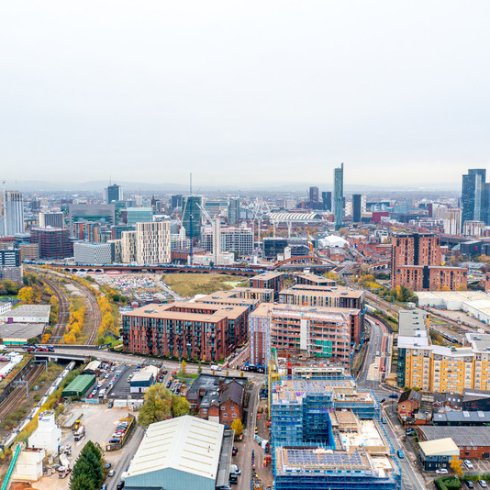
Our vision: The 5-Year Environment Plan 2025-2030
Vision - To create a nature-rich and carbon-neutral city region where all citizens have access to affordable renewable energy, warm climate-resilient homes, high-quality blue and green spaces, healthy and locally produced food, and a reliable, integrated, inclusive, sustainable and affordable transport system.
Target - To achieve a carbon-neutral city region by 2038.
Notes:
Thank you to all of our Chairs. I think you will agree that a great deal has been achieved over the past 5 years, but we all know there is still more to do.
I now want to outline our refreshed plan for the next 5 years
We remain committed to our ambitious target of achieving a carbon-neutral city region by 2038, despite the significant challenges ahead.
Our vision is clear: to create a nature-rich and carbon-neutral city region where all citizens have access to affordable renewable energy, warm climate-resilient homes, high-quality blue and green spaces, healthy locally produced food, and a reliable and affordable transport system.

Slide 3
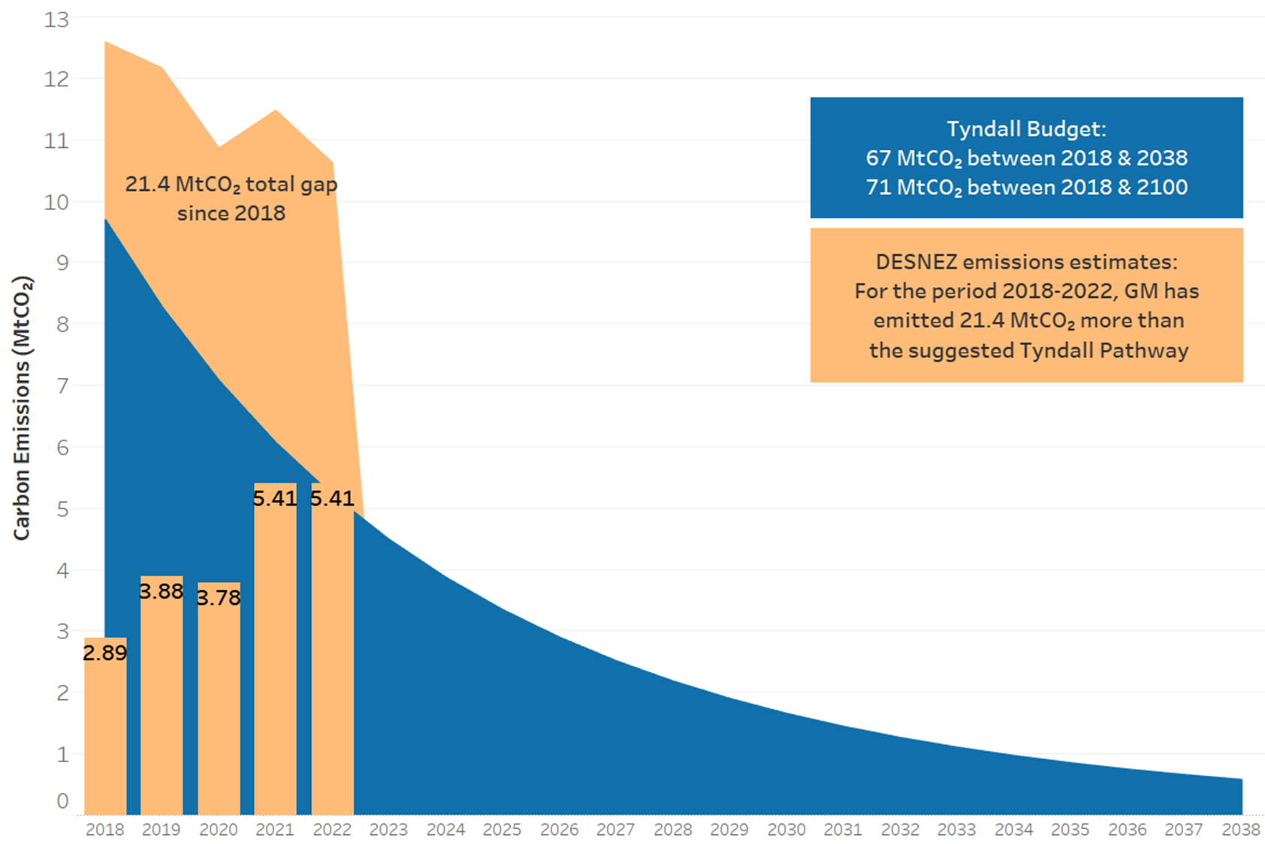
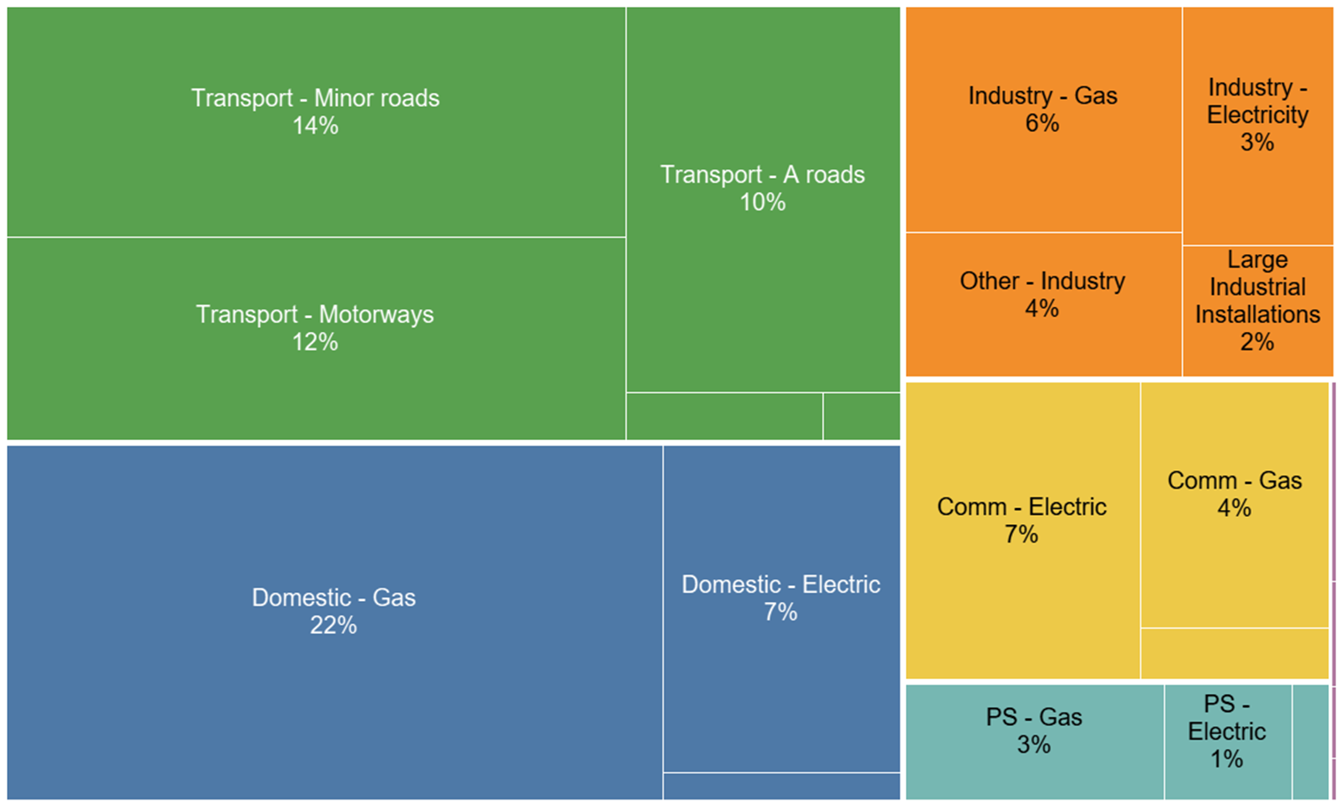
Delivering the challenge of 2038
Notes:
I think you will agree that a great deal has been achieved over the past 5 years, but we all know there is still more to do and we face many challenges ahead.
Our emissions have returned to a downward trajectory, following the immediate increase after the Covid-19 pandemic, and are now below the level seen in 2020. Our carbon emissions are falling too slowly to align with our science-based target and our natural environment is still in decline. Urgent and accelerated action is needed by all of us to reduce our carbon emissions and reverse the decline in biodiversity by 2030
As you can see from the chart, transport and domestic energy remain our largest two sources of carbon emissions and will remain the key areas where we need to make progress.
Today, you will hear about ongoing efforts to innovate in net zero housing, decarbonise business parks and industrial estates, and implement the Greater Manchester Transport Strategy 2040.
We are now near the end of our 2019 five-year environment plan. Although our science-based carbon budget may soon be exceeded, we believe that achieving carbon neutrality by 2038, whilst very challenging, is still achievable.
The new 5 Year Environment Plan creates a framework for all decision makers to take the next actions required to progress towards our long-term environmental vision and ensure everyone in Greater Manchester has a healthy, low carbon, nature-rich environment in which to live-well, prosper and grow. Whilst national and local government have a role to play in enabling and encouraging action, it is the decisions that we all take as citizens, businesses, communities, investors, home and car owners that will determine whether we will achieve our shared goals.
We will continue to drive progress against our new plan though our mission-based approach and our sector focused Challenge Groups.
And on that note, I have one last question for each of our 5 chairs.
Reflecting on your time working on the Five-Year Environment Plan, what do you see as the most significant opportunity for us in the next five years?
[All 5 chairs to answer in turn – Carly, Will, Megan, Anne, Louise, Mark. (30 secs each)

Slide 4
Structure of the Plan
Vision
What the longer-term vision for a greener GM looks like
Aims
The key long-term results required to achieve that vision for a greener GM
Objectives
The shorter term, specific results required to achieve our aims
Actions
The practical actions to be taken over the next 5 years that will contribute to delivering on our objectives.
Enabling Actions
The practical actions to be taken over the next 5 years that will facilitate the delivery of the above actions, through engagement, influencing and support
Notes:
The Plan follows the structure in the diagram
The vision is what we want a greener Greater Manchester to look like in 2038
The aims are the key long-term results required to achieve the vision
The objectives are the short term, specific results required to achieve our aims, each aim has a number of objectives associated.
Finally, each objective has a number of direct and enabling actions. The direct actions are the practical actions to be taken over the next five years that contribute to delivering on our objectives. The enabling action will facilitate delivery through engagement influencing and support.
A significant amount of the GMCA/LA actions sit under enabling actions where we are not in direct control but can support other organsisations to take action.

Slide 5
Our aims to deliver on the vision
Aims
Our energy infrastructure is smart, flexible and fit for a low carbon, sustainable future
Our buildings are sustainable and energy efficient
Our transport system is reliable, integrated, inclusive, affordable and enables sustainable travel
Our natural environment is enhanced, providing benefits for nature and people
Our city region transitions to a circular economy and our waste is reduced, reused, recycled or recovered
Our city-region is better adapted to the increasing impacts of climate change and is more resilient
Our air quality enhances the health wellbeing and quality of life of the city region
Our economy will grow sustainably because of the interventions we make benefitting our residents and businesses
Notes:
The plan has eight priority aims, this builds on the priorities in the last plan with the addition of two new aims on air quality and economy.
The other six aims continuing from the last plan are our energy infrastructure, our buildings, our transport and travel, our natural environment, our circular economy and waste, and resilience and adaptation.

Slide 6
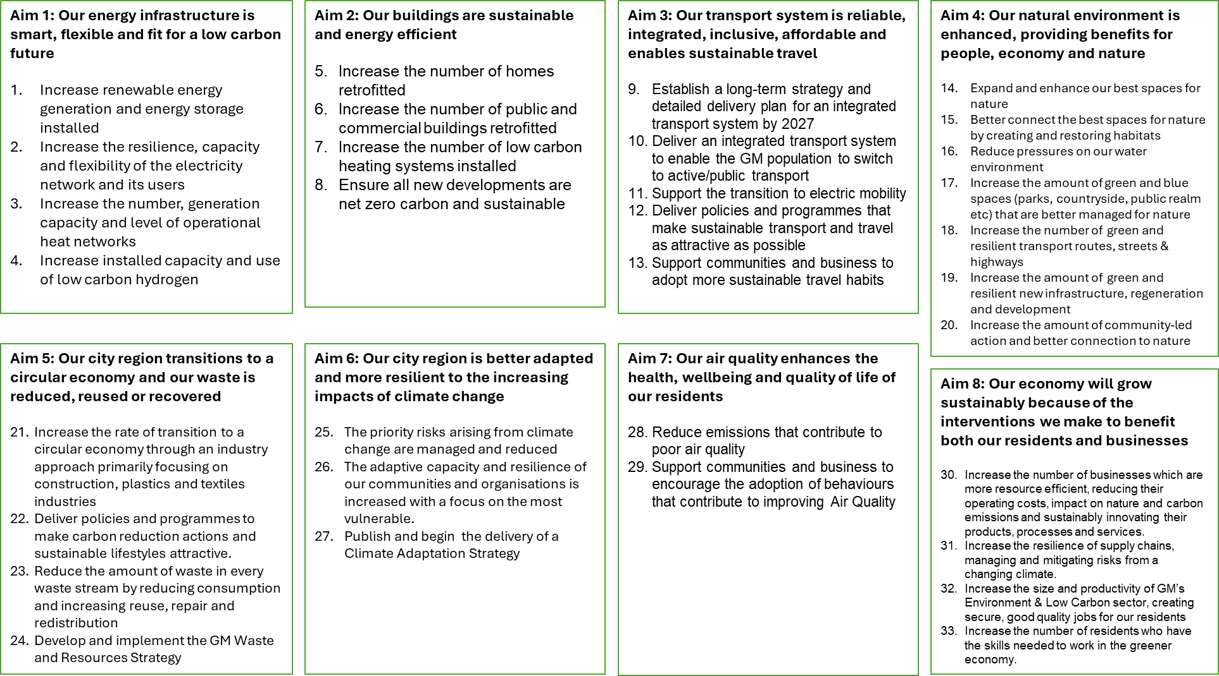

Slide 7
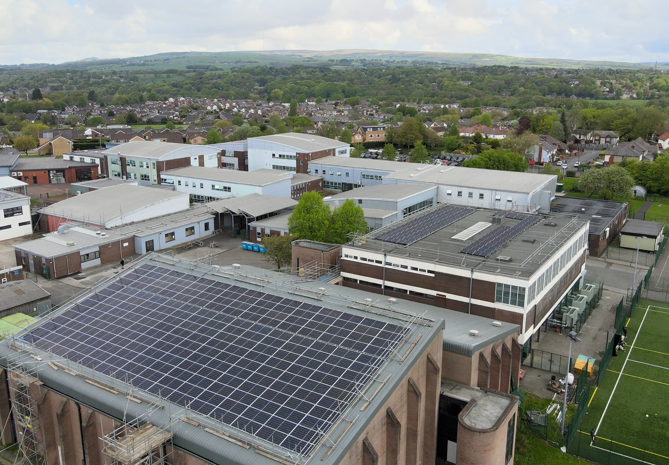
Energy Infrastructure
Increase renewable energy generation and energy storage installed
Increase the resilience, capacity and flexibility of the electricity network and its users
Increase the number, generation capacity and level of operational heat networks
Increase installed capacity and use of Low Carbon Hydrogen
Notes:
The transition of our energy infrastructure will underpin our acceleration to a low carbon economy. The government has ambitious targets to decarbonise the grid by 2030 and significantly increase the amount of renewable energy through GB Energy – Greater Manchester will be at the forefront of this transition, working with partners to improve our energy networks, and install new electricity and hydrogen capacity. A critical focus for us is also to start to see the next generation of district heat networks, providing renewable heat to our town and district centres and in our areas of growth and regeneration.

Slide 8

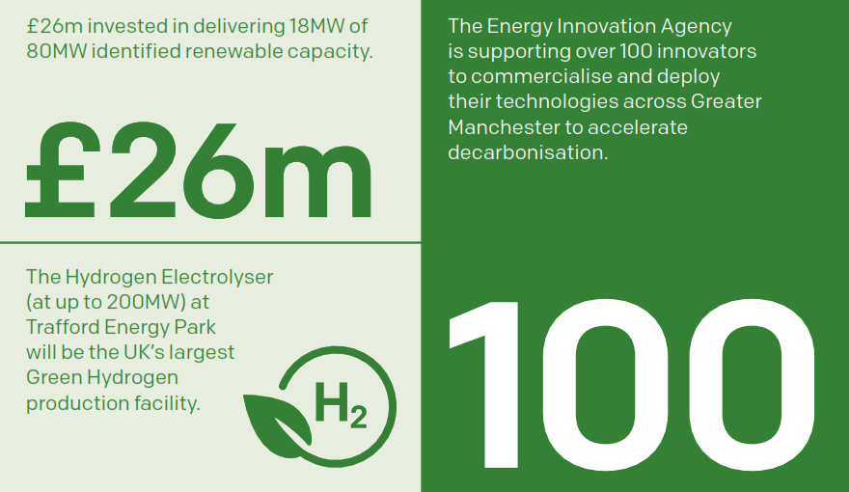

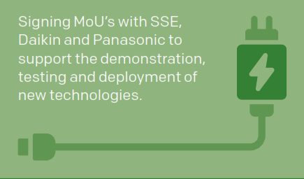
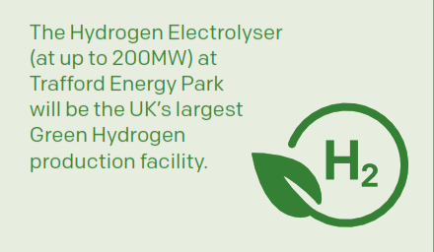
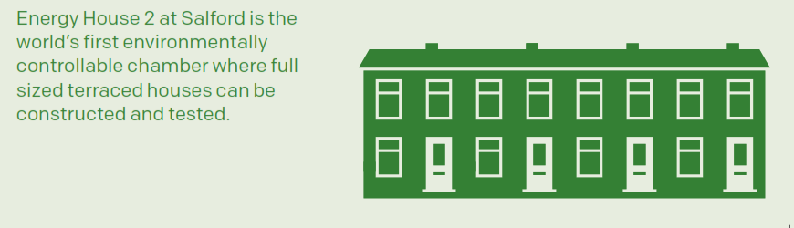
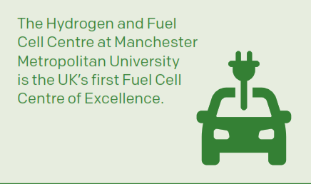
Notes:
Over the last 5 Years, we have significantly increased solar PV installations across public buildings and private homes, reducing carbon emissions and lowering energy costs. The implementation of smart energy grids has improved the efficiency and reliability of our electricity network.
The Hydrogen Electrolyser at Trafford Energy Park will be the UK’s largest Green Hydrogen production facility, and Energy House 2 at Salford is the world’s first environmentally controllable chamber for testing full-sized terraced houses.
The Greater Manchester Energy Innovation Agency’s establishment has seen support given to over 100 innovators to accelerate the commecialisation of new technologies to help drive forward our energy ambitions.
Greater Manchester is the first and largest City Region to develop smart Local Area Energy Plans that provide a geospatial plan for where energy generation, retrofit, low carbon heat and electric vehicle infrastructure should be installed/placed

Slide 9
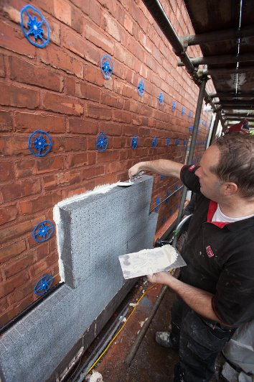
Buildings
Increase the number of homes retrofitted
Increase the number of public and commercial buildings retrofitted
Increase the number of low carbon heating systems installed
Ensure all new developments are net zero carbon and sustainable
Notes:
Providing good quality, affordable homes is a priority for Greater Manchester. As part of our Housing First approach we will need to see an acceleration in the number of homes retrofitted, in particular in our social housing and those in fuel poverty through our integrated settlement with government. We will also need to encourage retrofit and low carbon heating more generally across our housing, public sector and commercial stock, which will not just save carbon but also help to build the supply chain across the city-region. For new build we will need to implement our planning policies requiring all new development to be net-zero going forward.

Slide 10
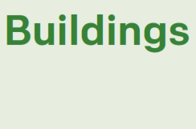

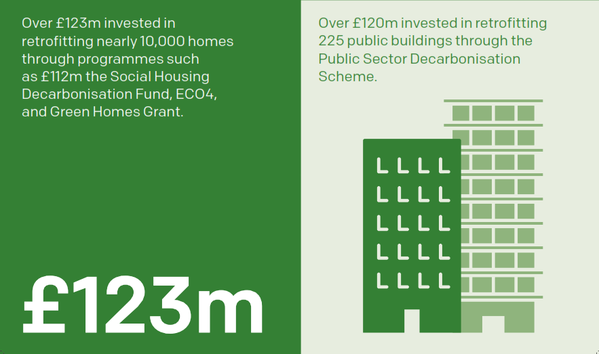

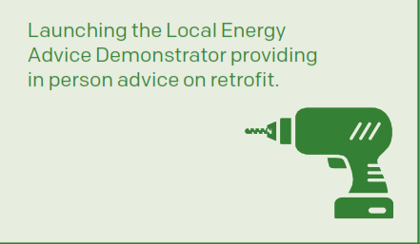
Notes:
Our retrofitting projects are enhancing the energy efficiency of existing buildings, reducing energy consumption and lowering carbon footprints.
Over £123 million has been invested in retrofitting nearly 10,000 homes, and over £120 million in retrofitting 225 public buildings
The Mayor has also launched a Truly Affordable Net Zero homes taskforce to deliver 30,000 net zero social homes
We have also secured £2m for a Local Energy Advice Demonstrator that provides in person retrofit advice to residents.

Slide 11
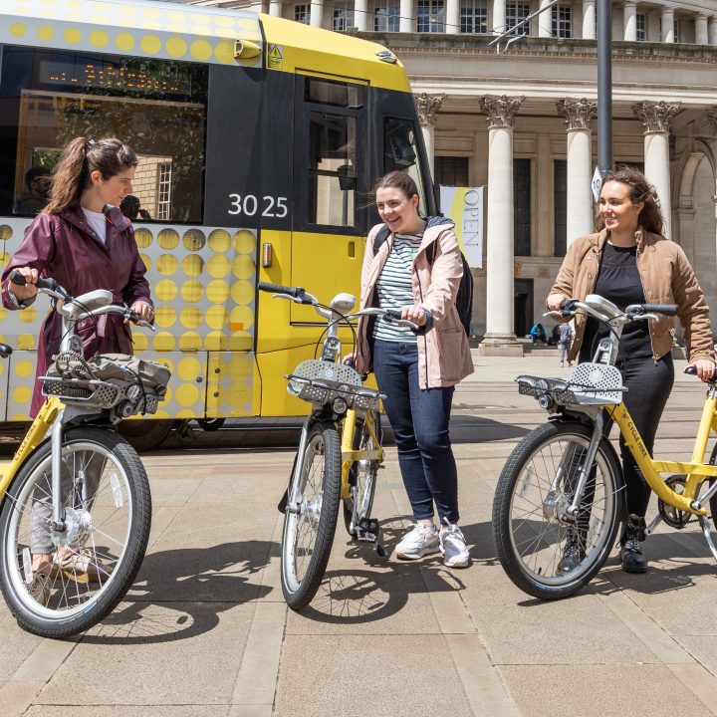
Transport
Establish a long-term strategy and detailed delivery plan for an integrated transport system.
Deliver an integrated transport system to enable the GM population to switch to active/public transport.
Support the transition to electric mobility.
Deliver policies and programmes that make sustainable transport and travel as attractive as possible.
Support communities and business to adopt more sustainable travel habits.
Notes:
Our Local Transport Plan (LTP) is a statutory document that sets out our long-term ambitions for transport as well as the policies and interventions to deliver our vision for transport in 2040. The plan is supported by a Five-Year Transport Delivery Plan which sets out the detailed delivery proposals, a spending plan and monitoring of the performance of transport delivery programmes – which the 5 Year Environment Plan looks to.
A refresh of the GM Transport Strategy 2040 and a new Delivery Plan for 2027-2032 is underway – you’ll hear more if you’re attending the transport workshop later this afternoon.
A major part of achieving a carbon neutral city region by 2038 and reducing our carbon footprint, will be moving to a public transport fleet which is zero emissions from tailpipe and supporting the transition to electric mobility.
We will grow and improve the existing Bee Network and work with local partners to improve local rail stations and services – indeed the final phase of bringing buses back under local control happens on 5 January with the south of the region and from 23 March we are introducing a full London-style tap in tap out system, daily cap.
By enhancing the connectivity and efficiency of walking, wheeling, cycling and public transport options and by supporting communities and business to adopt more sustainable travel habits we can make real changes to the way people travel In GM

Slide 12
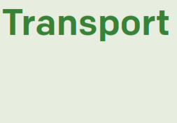
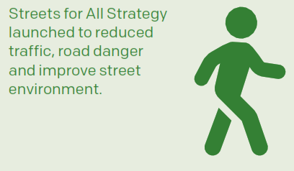
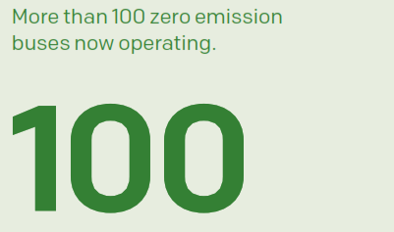
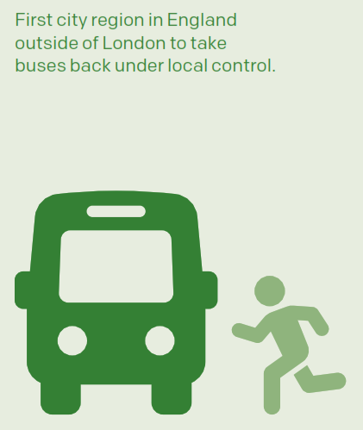
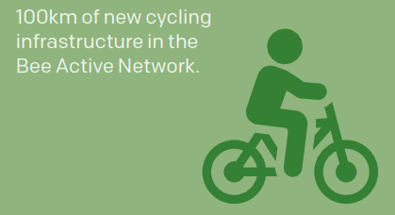
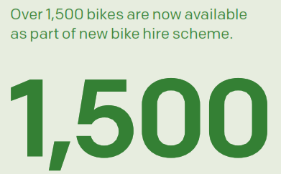
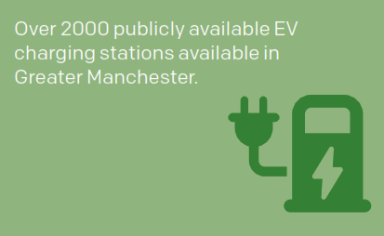
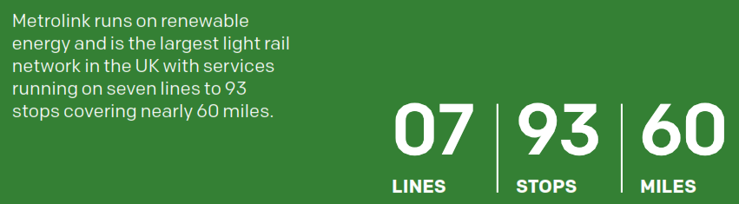
Notes:
Since the launch of the first 5 Year Environment Plan in 2019, Greater Manchester has made significant strides in enhancing its transport infrastructure.
Key achievements include the development of 100km of new cycling infrastructure as part of the Bee Active Network
Outside of London, we’re the first city region to bring buses back under local control through the Bee Network. This has seen the introduction of more than 100 zero-emission buses on Greater Manchester’s roads.
And there are now over 2,000 publicly available electric vehicle charging connectors.
We’ve also launched a bike hire scheme ‘Starling Bank Bikes’ and there over 1,500 bikes are now available for hire. And recently we hit the milestone for more than 1 million journeys being completed on these bikes.
We’ve also seen a Streets for All Design Guide adopted that sets clear guidelines for creating streets that are safe, inclusive, and accessible to all users. It focuses on reducing traffic congestion, lowering emissions, and promoting greener, more sustainable urban environments

Slide 13
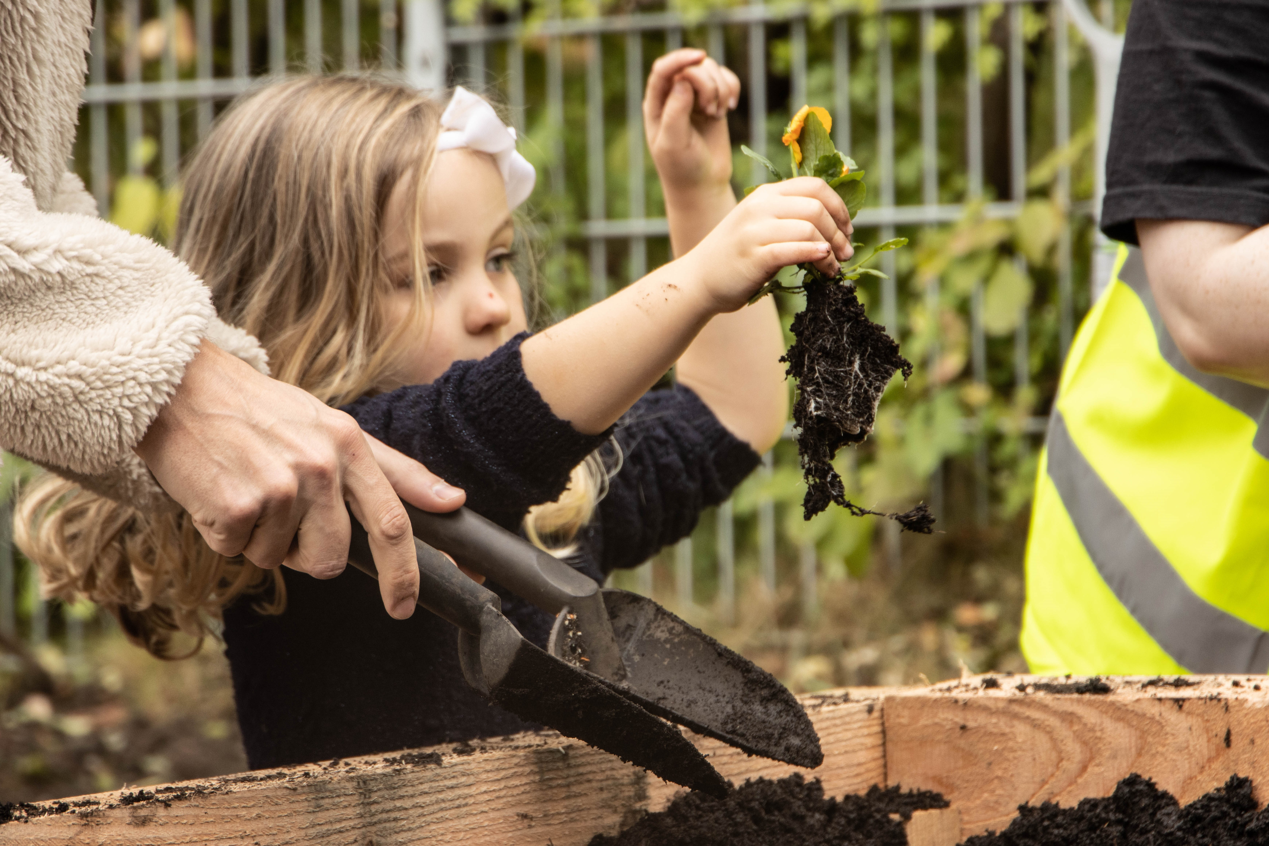
Natural Environment
Expand and enhance our best spaces for nature
Better connect the best spaces for nature by creating and restoring habitats
Reduce pressures on the water environment
Increase the amount of green and blue spaces (parks, countryside, public realm) that are better managed for nature
Increase the number of green and resilient transport routes, streets & highways
Increase the amount of green and resilient new infrastructure, regeneration and development
Increase the amount of community-led action and better connection to nature
Notes:
To respond to the biodiversity emergency, and deliver on our Local Nature Recovery Strategy, we need to make space for nature, and also provide more opportunities for people to connect with their natural environment and the benefits that provides.
To do this, we need to focus on expanding and enhancing our best spaces for nature, and connect them up more – giving nature space to thrive.
We need to reduce pressures on the environment, particularly on our rivers, streams and canals, continuing to deliver on our integrated water management plan.
We also need to bring nature closer to people – in the parks and green spaces they visit and use, along the streets they walk and wheel, in new development and infrastructure (more on that from Tony Juniper and Andy this afternoon) and in their communities, through supporting community groups to take action.

Slide 14

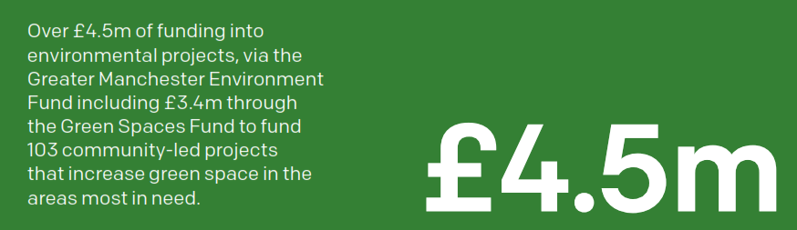

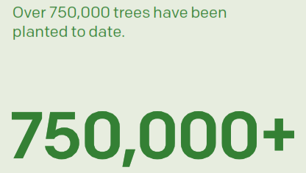


Legacy of the Natural Course and IGNITION projects built on through agreement and delivery of an Integrated Water Management Plan.
Over £6.3m into environmental projects, including £5.5m delivered through the Greater Manchester Environment Fund and over 100 community-led Green Space Fund projects
£6.3m
Enhanced 140km of waterbodies and delivered programme of activities to improve water management as part of the Natural Course project.
Over 570,000 trees planted by City of Trees over the last five years.
570,000+
IGNITION Living Lab established to explore and engage businesses and residents on the benefits of nature-based solutions.
Greater Manchester Natural Capital Investment Plan launched and GM wide approach to Biodiversity Net Gain implemented.
Statutory Local Nature Recovery Strategy has been drafted and is currently out for public consultation.
Notes:
Green spaces across the city-region provide essential benefits for people and wildlife, improving air quality, our health and wellbeing, and supporting species.
In 2022, the Mayor declared a biodiversity emergency for Greater Manchester, reflecting the precarious state of nature here and the risks that the continued decline in nature poses to our economy and our residents health and wellbeing.
We have made good progress over the 5 past years – but nature is not yet recovering and those benefits are still at risk.
Since 2019, 140km of our rivers have been enhanced and in 2022 we launched an Integrated Water Management Plan to improve water quality and manage water sustainably. Tree planting campaigns have increased the urban tree canopy, mitigating climate change effects. Over the last 5 years, led by City of Trees, organisations and councils across Greater Manchester have planted 570,000 trees, with 917,000 trees planted to date. Volunteers have been crucial, residents and organisations have spent 100,000 hours improving our natural environment. And we’ve brought in and deployed new funding through our partners, including the Greater Manchester Environment Fund, into delivery of projects on the ground that have contributed to these successes. This includes the 100+ Green Spaces Fund projects, led by community groups, that have been funded to date.
To set out our pathway for the future, our draft Local Nature Recovery Strategy for Greater Manchester is out for public consultation right now.

Slide 15
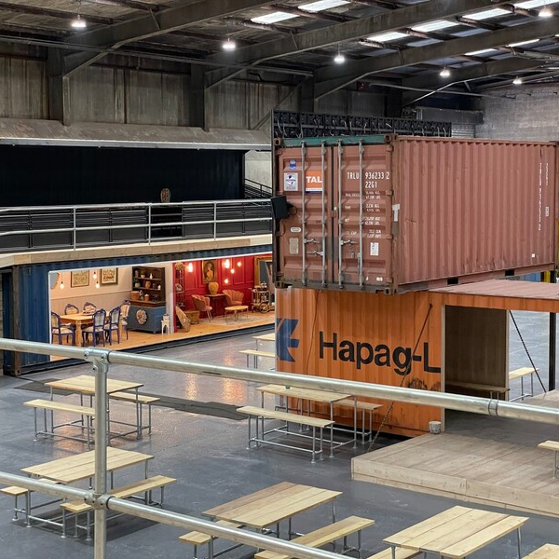
Circular Economy and Waste
Increase the rate of transition to a circular economy through an industry approach primarily focusing on construction, food, plastics (including packaging) and textiles
Deliver policies and programmes to make carbon reduction actions and sustainable lifestyles attractive
Reduce the amount of waste in every waste stream by reducing consumption and increasing reuse, repair and redistribution
Develop and implement the Greater Manchester Resource and Waste Strategy
Notes:
Circular Economy and Waste has 4 key objective within the new plan, firstly to increase the transition to a circular economy by working with industry in 4 key areas construction, food, plastics and textiles. By keeping resources in the system for longer we will reduce the amount of waste created and by increasing reuse, repair and redistribution.
We'll be developing policies and programmes to support residents and businesses make carbon reduction actions and sustainable lifestyles choices more appealing.
A new Greater Manchester Resource and Waste Strategy will also be developed which will focus on capturing waste that remains within the system and recycling as much as possible.

Slide 16
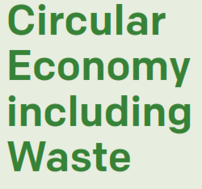
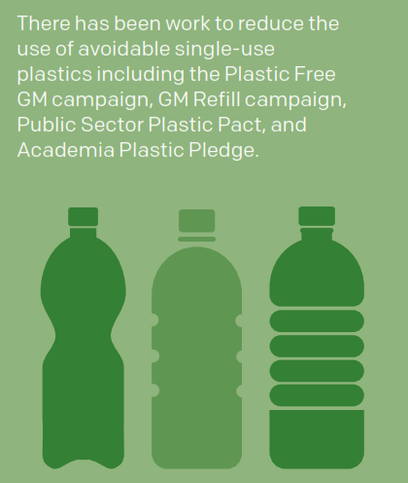


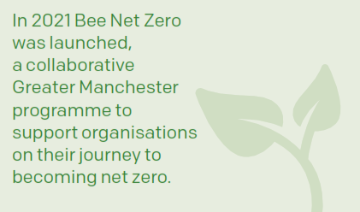


Notes:
Businesses in Greater Manchester are adopting more sustainable practices thanks to our Bee Net Zero programme.
We continue to invest in community action through the Community Recycling Fund. Launched in 2021, it has funded creative solutions to recycling, repairing and reusing household waste in Greater Manchester. So far 47 projects have been funded including cooking classes, repair cafes and educational workshops.
Our Renew Hub supports the transition to a circular economy by providing a central facility for recycling and reusing unwanted items, fostering community engagement, creating job opportunities, and promoting sustainable living practices.
There has been work to reduce the use of avoidable single-use plastics including the Plastic Free GM campaign, GM Refill campaign, Public Sector Plastic Pact, and Academia Plastic Pledge.
A Schools Climate Action Planner has been launched to provide schools with a free, online, action planning tool to reduce their carbon footprint and environmental impact. 10 schools are also trialling being Eco-Refill Shops and Greater Manchester has become a Refill Destination.
We are making good progress, the next step is to accelerate the scale and speed of delivery.

Slide 17
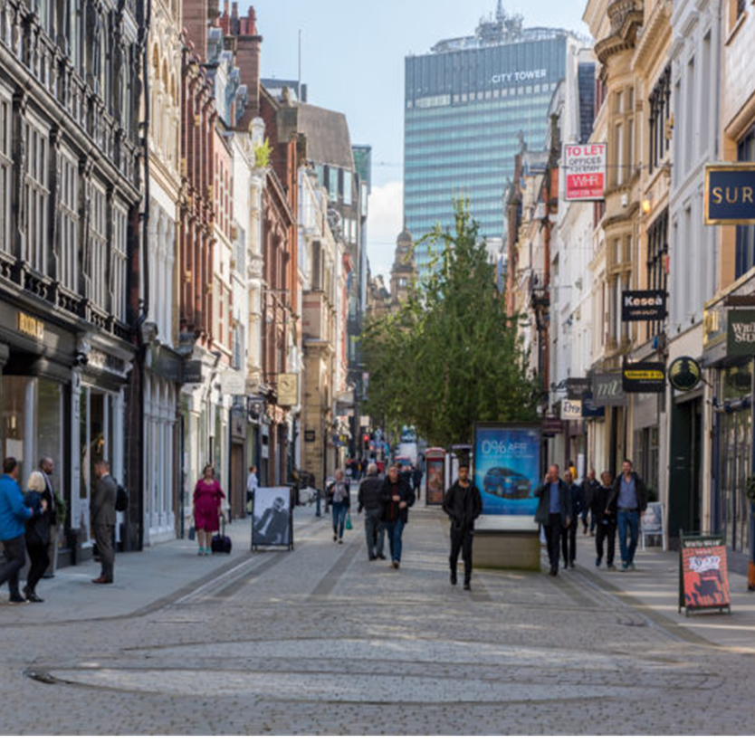
Economy
Increase the number of businesses which are more resource efficient, reducing their operating costs, impact on nature and carbon emissions and sustainably innovating their products, processes and services
Increase the resilience of supply chains, managing and mitigating risks from a changing climate
Increase the size and productivity of GM’s Environment & Low Carbon sector, creating secure, good quality jobs for our residents
Increase the number of residents who have the skills needed to work in the greener economy
Notes:
It is intended that our Environment Plan will fully align with Greater Manchester’s emerging Local Growth Plan, by supporting businesses to adopt more sustainable business models and stimulating growth in the region’s clean growth sectors.
Greater Manchester’s clean growth sector comprises over 3000 companies employing nearly 60,000 people, representing 14.5% of the business base and we want to see this grow by at least 7% per annum.
The sector is already a national leader in carbon capture & storage, energy management and renewable energy consultancy and ranks second in the UK for alternative fuel vehicles and carbon finance.
The fastest growing subsectors are in Building Technologies, Wind and geothermal energy . Waste, Recycling & Circular Economy are also identified as being areas of current strength and potential growth areas.
Our transition to a sustainable, low carbon city region will require significant long-term investment by our businesses, public bodies and residents. We estimate that an additional £19Bn will be required between now and 2038.
This level of investment is without precedent in modern times in terms of scale, scope and duration. It will create new industries and grow and diversify existing ones.
We need to give confidence to Greater Manchester green sector business to innovate and invest in scaling up to meet this future demand
To achieve this, we need to give local businesses, training providers and our residents the certainty they require, in terms of what transitions will happen and when, to give them confidence to invest in growing their businesses and their career skills respectively. We aim to do this by creating and investable pipeline of up to £1bn of low carbon projects by April 2026 through our net zero accelerator programme.

Slide 18
Low Carbon Sector Development
Notes:
It is intended that our Environment Plan will fully align with Greater Manchester’s emerging Local Growth Plan, by supporting businesses to adopt more sustainable business models and stimulating growth in the region’s clean growth sectors.
Greater Manchester’s clean growth sector comprises over 3000 companies employing nearly 60,000 people, representing 14.5% of the business base and we want to see this grow by at least 7% per annum.
The sector is already a national leader in carbon capture & storage, energy management and renewable energy consultancy and ranks second in the UK for alternative fuel vehicles and carbon finance.
The fastest growing subsectors are in Building Technologies, Wind and geothermal energy . Waste, Recycling & Circular Economy are also identified as being areas of current strength and potential growth areas.
Our transition to a sustainable, low carbon city region will require significant long-term investment by our businesses, public bodies and residents. We estimate that an additional £19Bn will be required between now and 2038.
This level of investment is without precedent in modern times in terms of scale, scope and duration. It will create new industries and grow and diversify existing ones.
We need to give confidence to Greater Manchester green sector business to innovate and invest in scaling up to meet this future demand
To achieve this, we need to give local businesses, training providers and our residents the certainty they require, in terms of what transitions will happen and when, to give them confidence to invest in growing their businesses and their career skills respectively. We aim to do this by creating and investable pipeline of up to £1bn of low carbon projects by April 2026 through our net zero accelerator programme.

Slide 19
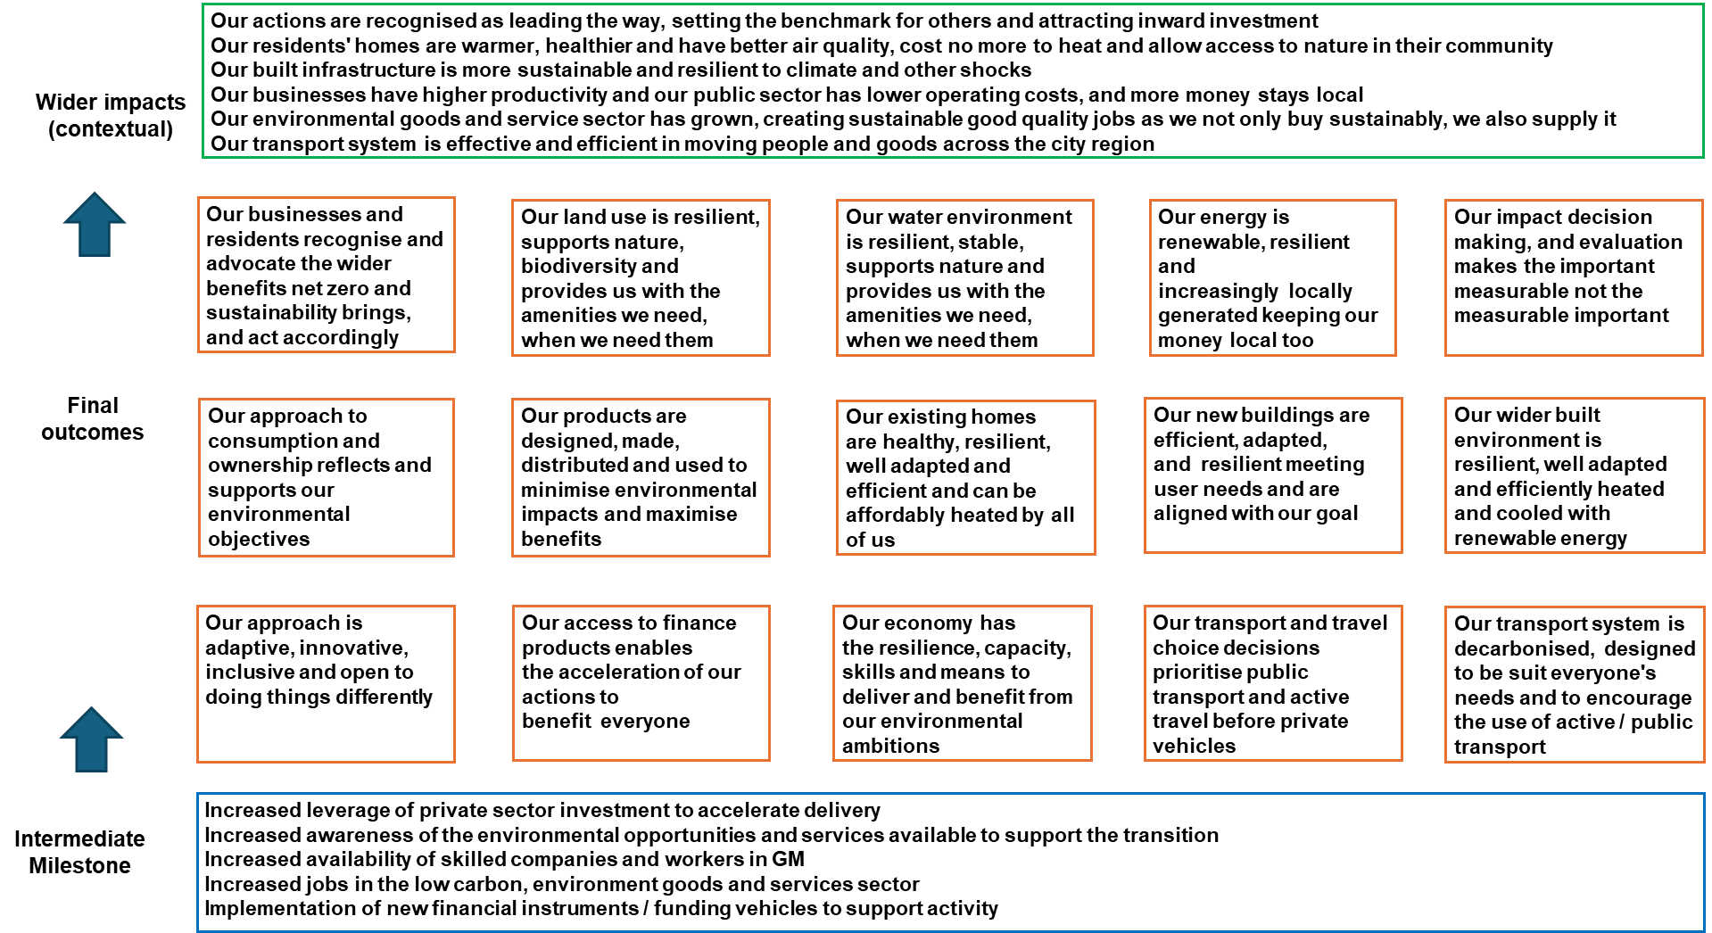
What it will look like if we succeed
Notes:
This slide shows an overview of everything the next 5YEP is aiming to achieve.
The intermediate milestones reflect factors needed to support delivery of outcomes including increased private sector investment, increased skilled workers and companies and new financial instruments/funding vehicles
The final outcomes cover both environmental outcomes and broader cross-cutting outcomes
The environmental outcomes include; increasing renewable energy generation, protecting biodiversity, increasing public and active transport, retrofitting homes and commercial buildings, sustainable consumption and production and efficient new build.
The cross cutting outcomes include; developing impact decision making that reflects environmental ambitions, increasing innovation, increased access to finance and sufficient skills and supply chain capacity.
The wider impacts achieved by the outcomes include higher productivity, a growing green sector, improved lives of residents, inward investments

Slide 20

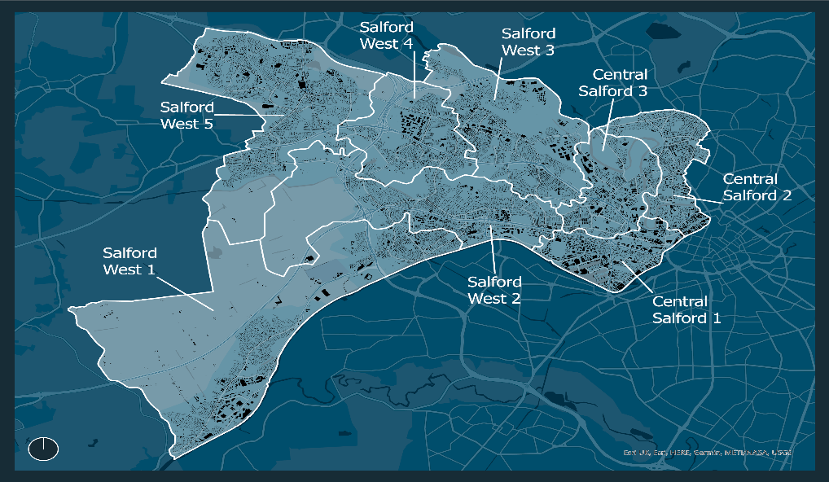









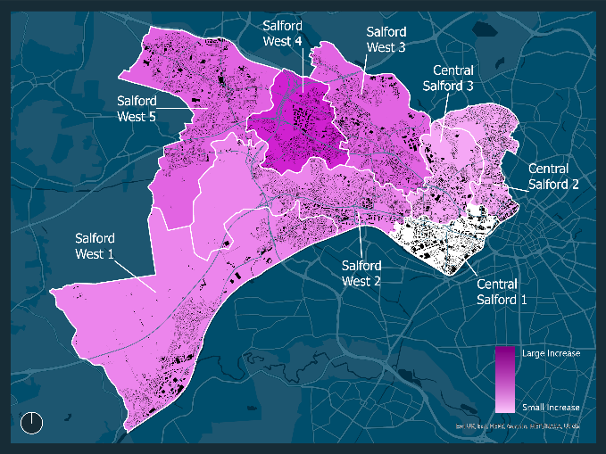
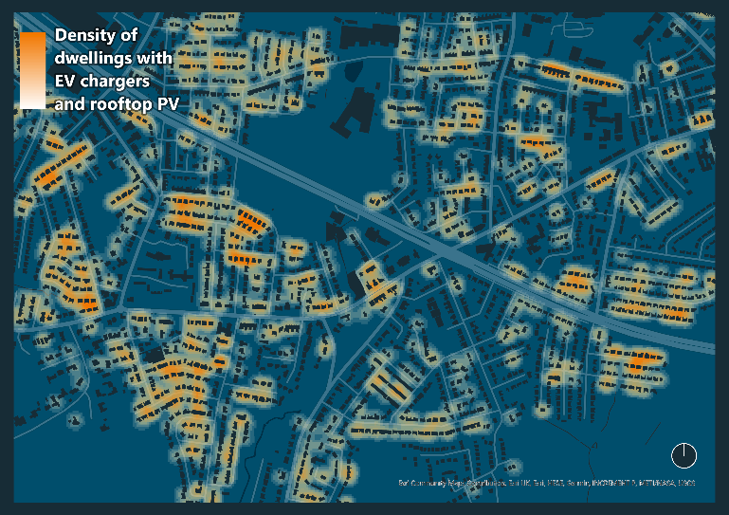
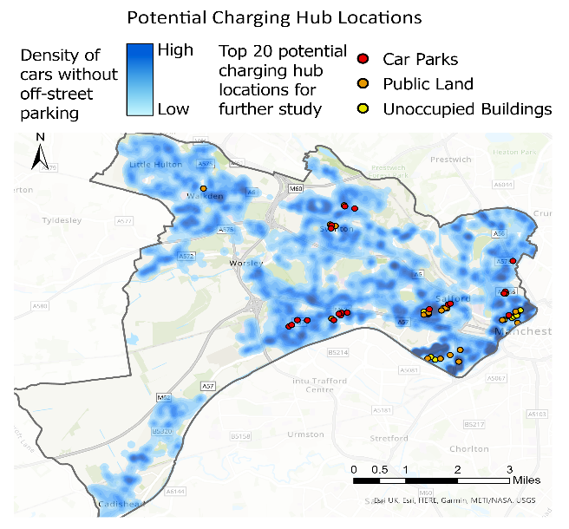
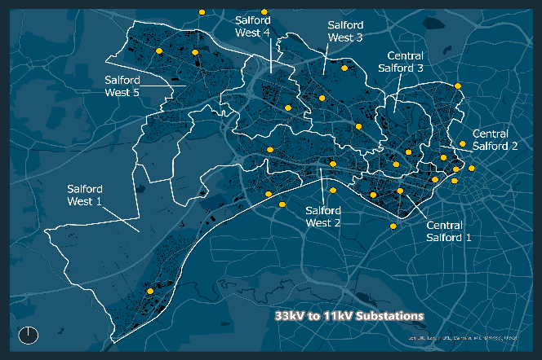

Local Area Energy Plans
Priority Areas for demonstration and scale
Retrofit Analysis
Solar PV and EV density by 2038 Salford west 4
Energy networks

Slide 21
DESNZ Accelerator Overview:
Testing 3 scales of aggregation to develop new models
Programme Work-packages
0. Programme Management, Learnings and Cross Collaboration
Workstream Outcomes
Regional Investment and Delivery Vehicle(s)
Secured JV Partner and Delivery of Oldham Green New Deal
Mapped pipeline to feed into regional investment programme
Integrated low carbon transport models
Expanded Heat, Electricity Generation, and Storage Delivery Model
Optimised Retrofit Programme
Evidence base to expand, replicate and scale
Commercial models and aggregation will be tested at 3 scales
Regional
Place-based investment pipelines
2. District Trailblazer
Oldham – Community Led
3. Neighborhood Trailblazer
MCC – Regeneration Led
Bi-directional
Pipeline and project development
4. Mobility Scale Up
5. Heat, Generation and Storage Scale Up
6. Scaled up Retrofit (with Devolution)
7 Measure, Evidence and Scale
The DESNZ Accelerator programme will create the trajectory for Carbon Neutrality in GMCA

Slide 22
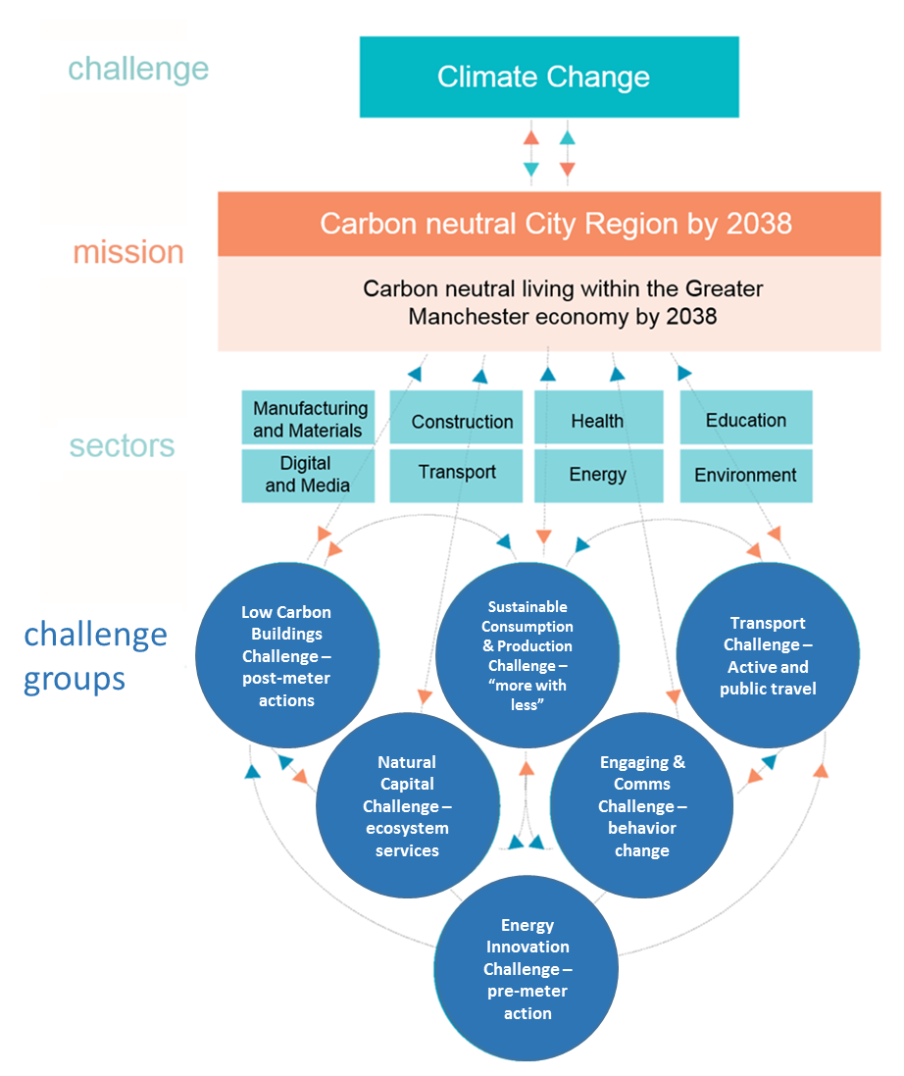
…if we all take action together now
….a Mission Based Approach
Notes:
The plan will only deliver if we all take action – the Plan sets out what we need to do urgently now to put us on an ambitious path for the longer term. We also need to use it to track and report on progress – so it doesn’t sit on the shelf but drives action and is used to adapt our approach over the next 5 years.
Achieving our goals will be challenging – it needs new ways of doing things that we (as individuals, businesses, the voluntary/charity and social enterprise sector, the public sector) can all get behind. To do that, we have established the UK’s first city region Clean Growth Mission for carbon neutral living here by 2038, driving innovation, the creation of new technologies, and improved resource efficiency.
This approach will act to bring together people, businesses, voluntary organisations and the public sector – around a central mission. This involves:
Defining an ambitious goal
Using this to create a long-term policy landscape and
Collectively setting out tasks to mobilise people and groups to come together in new ways, that cut across traditional sectors, to deliver transformational change

Slide 23



Governance
Green City Region Governance – Mission Based Approach
Key Influencers
Legend
Growth Board
= Advisory – Non Decision making
= Elected Member Representation
GMCA
= Decision making
= Mayoral Priority Focus
GM Green City Region Board
Cllr Tom Ross
10 x District Portfolio Leads
Green City Region Partnership
Cllr Tom Ross
LEP
Programme Delivery Executive
- Policy (Energy, Waste, Buildings, Transport, LIS)
- Investment, Research, Skills, Communications
Sue Johnson
Integrated Care Board
Wider Leadership Team
Sue Johnson
GM Retrofit Taskforce
Andy Burnham
Open Forum (Quarterly)
– Cross cutting
- Support and Challenge
GM Waste & Recycling Committee
Public Sector (Monthly)
- LA/Public sector focus
- Topic focused
LA Climate Emergency/5YEP
Mark Atherton
Decarbonising Public Estate
Mark Atherton
5 Year Environment Plan Forum
Carly Mclachlan
GM Transport Committee
GM Strategic Infrastructure Board
Challenge Groups (Quarterly)
Target driven, Outcome focused
Topic based Task Leads
Sustainable Consumption/ Production Challenge
Paul Hooper
Low Carbon Challenge
Richard Halsey
Communications Challenge
Louise Blythe
Natural Capital Challenge
Anne Selby
GM Planning and Housing Commission
Task & Finish Groups
(examples - as needed)
Problem solving, task delivery
Circular Economy models
Retrofit Finance
Local Energy Market
PV Uptake
Public Buildings Retrofit
Energy Transition region
SUDs
Master
Planning
Notes:
A complex governance structure has been established to oversee this work. A new Green City Region Partnership Board has been formed that brings together the chairs of the Challenge Groups with representatives fro each of our statutory committees.
The Challenge Groups have identified each identified priority tasks and assigned people to working groups to identify how we can drive the agenda forward.
The next few slides give an overview of the Challenge Groups have divided work into Task and Finish Action Groups and what those groups are currently working on.

Slide 24
Thank you
#GMGreenSummit
Notes:
To be successful, we need to put people at the heart of our plans and help develop the skills, knowledge and leadership that will enable them to support our pathway to 2038 and benefit from it.
Greater focus will therefore be placed on engaging with the people and businesses of Greater Manchester on our shared vision for the future, listening to their concerns and aspirations and giving them the support and encouragement they need on the journey towards a nature rich and carbon neutral city region.
Thank you to all our Challenge Group Chairs. It is great to have you all on board today to work together on overcoming the challenges we face. Together we can make a real difference.
Thank you

