Slide 1
The situation for Swedish teachers 1990-2022 Pontus Bäckström, Head of Analysts The National Union of Teachers in Sweden

Slide 2
Three pfases of development
Deregulation, decentralization, privatization
Governmental control and regulation
Reintroduced regulations
Lgr62
Lgr69
Lgr80
Lpo94
Lgr11
Curricula
?
1946
1950
1960
1970
1980
1990
2000
2010
2015
Post-war: School Commission
Post-war: Trials with common compulsory schools
Common compulsory school reform (1962)
Increased unity, also upper-secondary schools (1970)
Decentra-lization (1989)
Upper-secondary school reform (1991),
School voucher reform (1992), new curricula (1994)
Vast reform agenda (2006/2010)
School Commission No2 (2015)

Slide 3
Swedish results
111%
113%
109%
Source: OECD, PISA 2000-2018
Source: IEA, TIMSS 2011-2019

Slide 4
Teachers’ situation
Source: The Swedish National Agency for Education
Source: The Swedish National Agency for Education

Slide 5
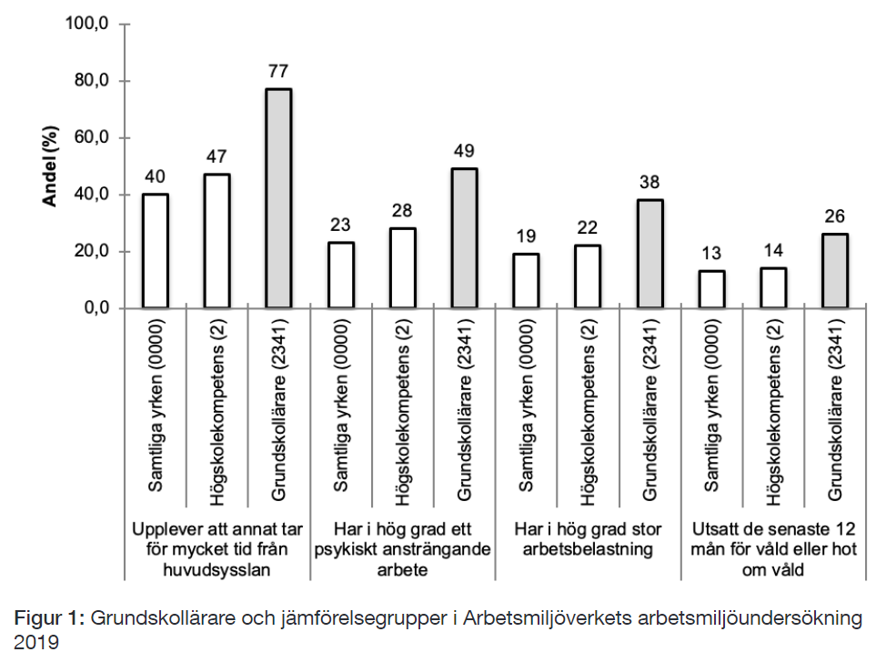
Teachers’ situation
Indicators of working environment in Sweden, 2019
Source: National Union of Teachers
Source: Bäckström (2021), from Statistics Sweden

Slide 6
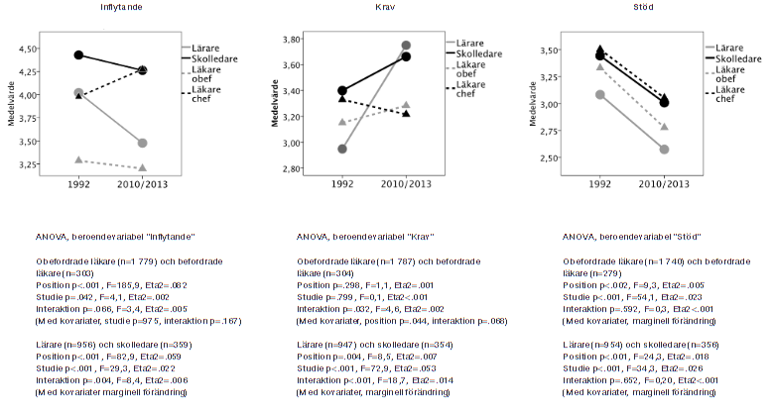
Teachers’ situation
Source: Kjellström et al. (2016)

