Slide 1
Swedish National Agency for Higher Vocational Education
Margareta Landh, senior adviser

Slide 2
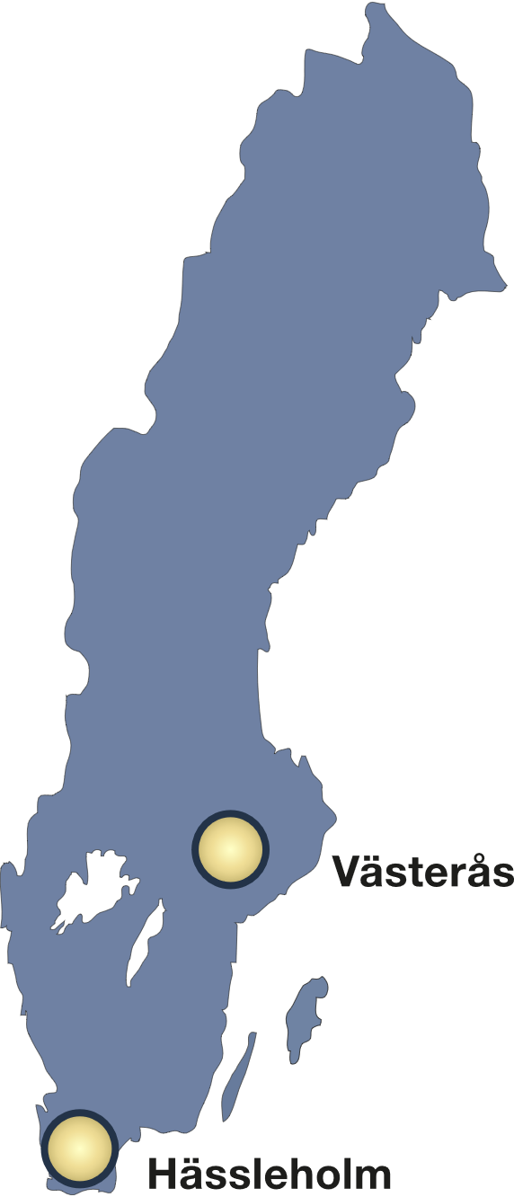
About us
Established in 2009
Under the Ministry of Education and Research
Director-General Thomas Persson
Västerås office and Hässleholm office
140 employees
Website: www.myh.se

Slide 3
Areas of responsibility
Higher Vocational Education (HVE)
Post-secondary Arts and Culture courses
Interpretation courses and programmes
Validation of Prior Learning
Swedish National Qualifications Framework (SeQF)

Slide 4
Organisation
KL
Skill Supply & Lifelong Learning

Slide 5
Advisory and support bodies
Transparency Advisory Board – observes activities and provides advice to the Director-General.
Labour Market Advisory Board – provides labour market information relevant for the higher vocational education sector.
Advisory Board for Access Courses to Higher Education in Art – advises on funding to Access Courses to Higher Education in Art. Assists in the shaping of criteria, indicators and principles on follow-up and quality assurance reviews.
Swedish National Qualifications Framework Advisory Board – provides information to support decision making on qualification level placement in the Swedish National Qualifications Framework, SeQF.

Slide 7
The Swedish
Education System
https://www.cedefop.europa.eu/files/4168_en.pdf

Slide 8
The Swedish Higher Vocational Education
Training for specific vocations
Programmes offered nation wide
Employers contribute to the shaping and running of the study programmes
Extensive periods of work based learning are part of most programmes
Basic entry requirement is school leaving diploma from upper-secondary school (gymnasieexamen)
Study programmes 1 to 3 years in duration (1 year = 200 HVE credits)
Range of study programmes vary over time
All study programmes qualify for student finance (Swedish Board of Student Finance) and most of them are free of charge for students
Average age of students – approx. 30 years

Slide 9
Distinguishing features
Industry and labour market involvement
Designed to meet labour market demands
Each programme is managed by a board
Extensive periods of work based learning are part of most programmes
Tertiary vocational education (EQF level 5 & 6)

Slide 10
Board connected to the programme
Each study programme is managed by a board
Members are mainly employers from the sector or industry relevant to the study programme
One student member

Slide 11
Basic Structure of HVE-programmes
Managing Board
Education Provider
Students
Unique curricula, developed by providers
Adjustable course plans
Flexible setup
1/3 to 1/4 Work Based Learning

Slide 12
Establishing Higher Vocational Programmes
Initiatives from employers
Education providers
Application to MYH
Approval or disapproval

Slide 13
Our tasks related to HVE
Approval of HVE programmes and allocation of public funding
Analyse labour market needs and demand
Conduct inspections
Quality Assurance Reviews
Produce statistics
Promote quality development in HVE programmes

Slide 14
Analysing labour market demand
To analyse the demand for qualified workforce in relation to the current development in the labour market
Create the broad picture – what is most important?
The analyses are used as complementary information and they are one of the sources in the assessment of the application

Slide 15
Key performance indicators 2021
227 HVE providers ( 93 public and 134 private)
3 200 programmes running during 2021 (some are the same programmes, with different starting dates)
2,0 applicants fulfilling entry requirements per financed study place
86 000 students
35 800 individuals started their studies
17 00 graduates and graduation rate was 72 percent (for 2020).
89 percent of graduates (in 2020) was in employment 2021
Notes:
67 percent av dessa hade ett arbete som överensstämde helt eller till största delen med utbildningen.
Higher vocational education is to increase by 50 percent

Slide 16
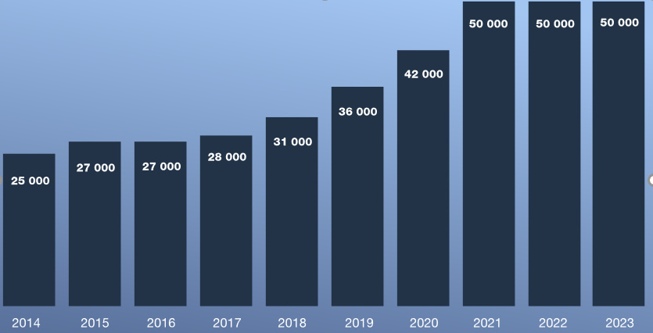
Utbetalda årsplatser med prognoser för 2021, 2022 och
Higher vocational education has increased in volume
Prognosis
Notes:
2014 och framåt
Tydligt att vi med 2021 når dubbelt 2014

Slide 17
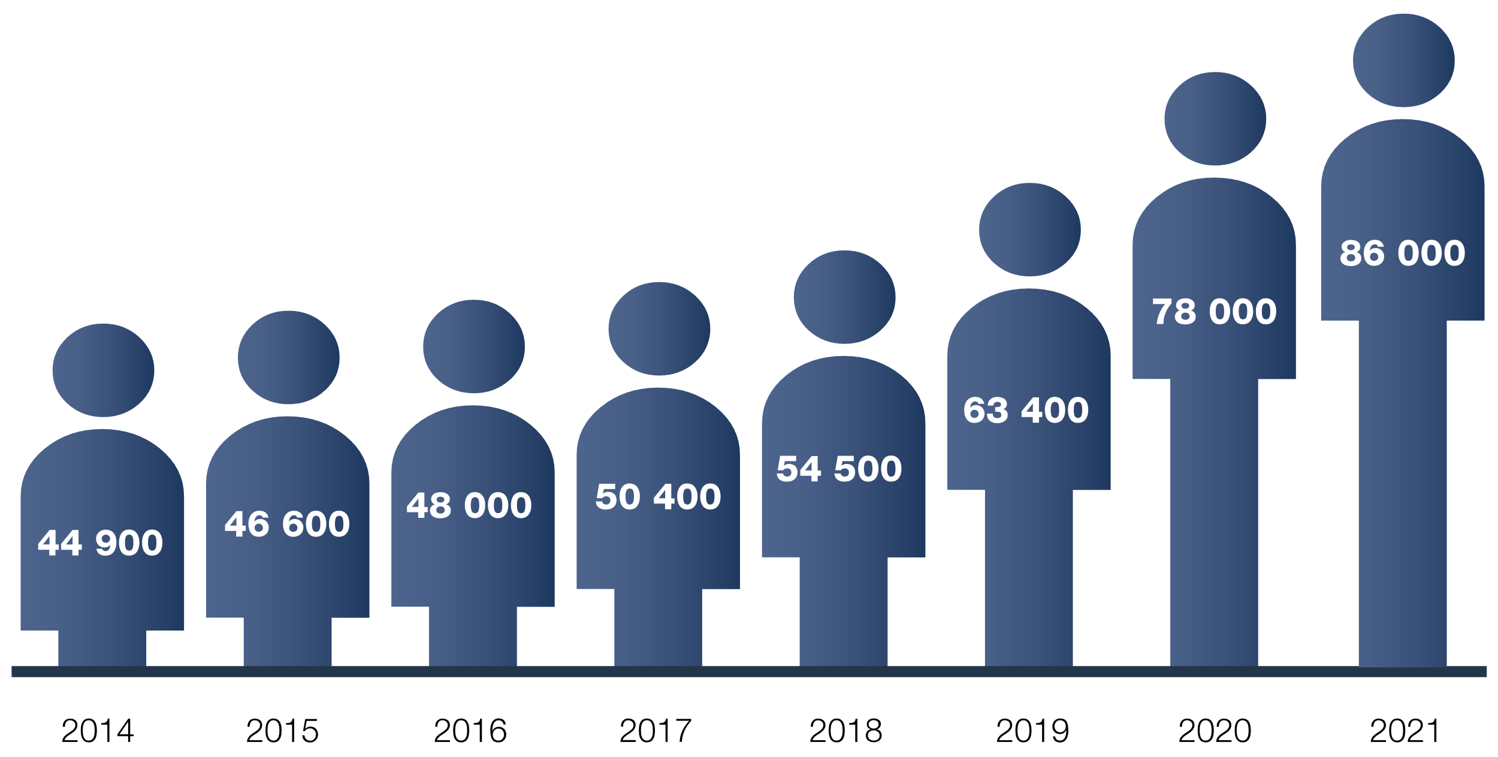
Number of active students

Slide 18
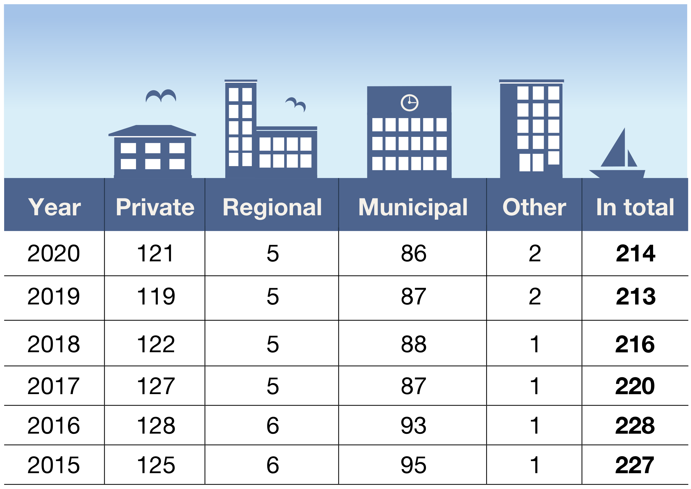
HVE providers
Notes:
Med minst en pågående YH-omgång under året.

Slide 19
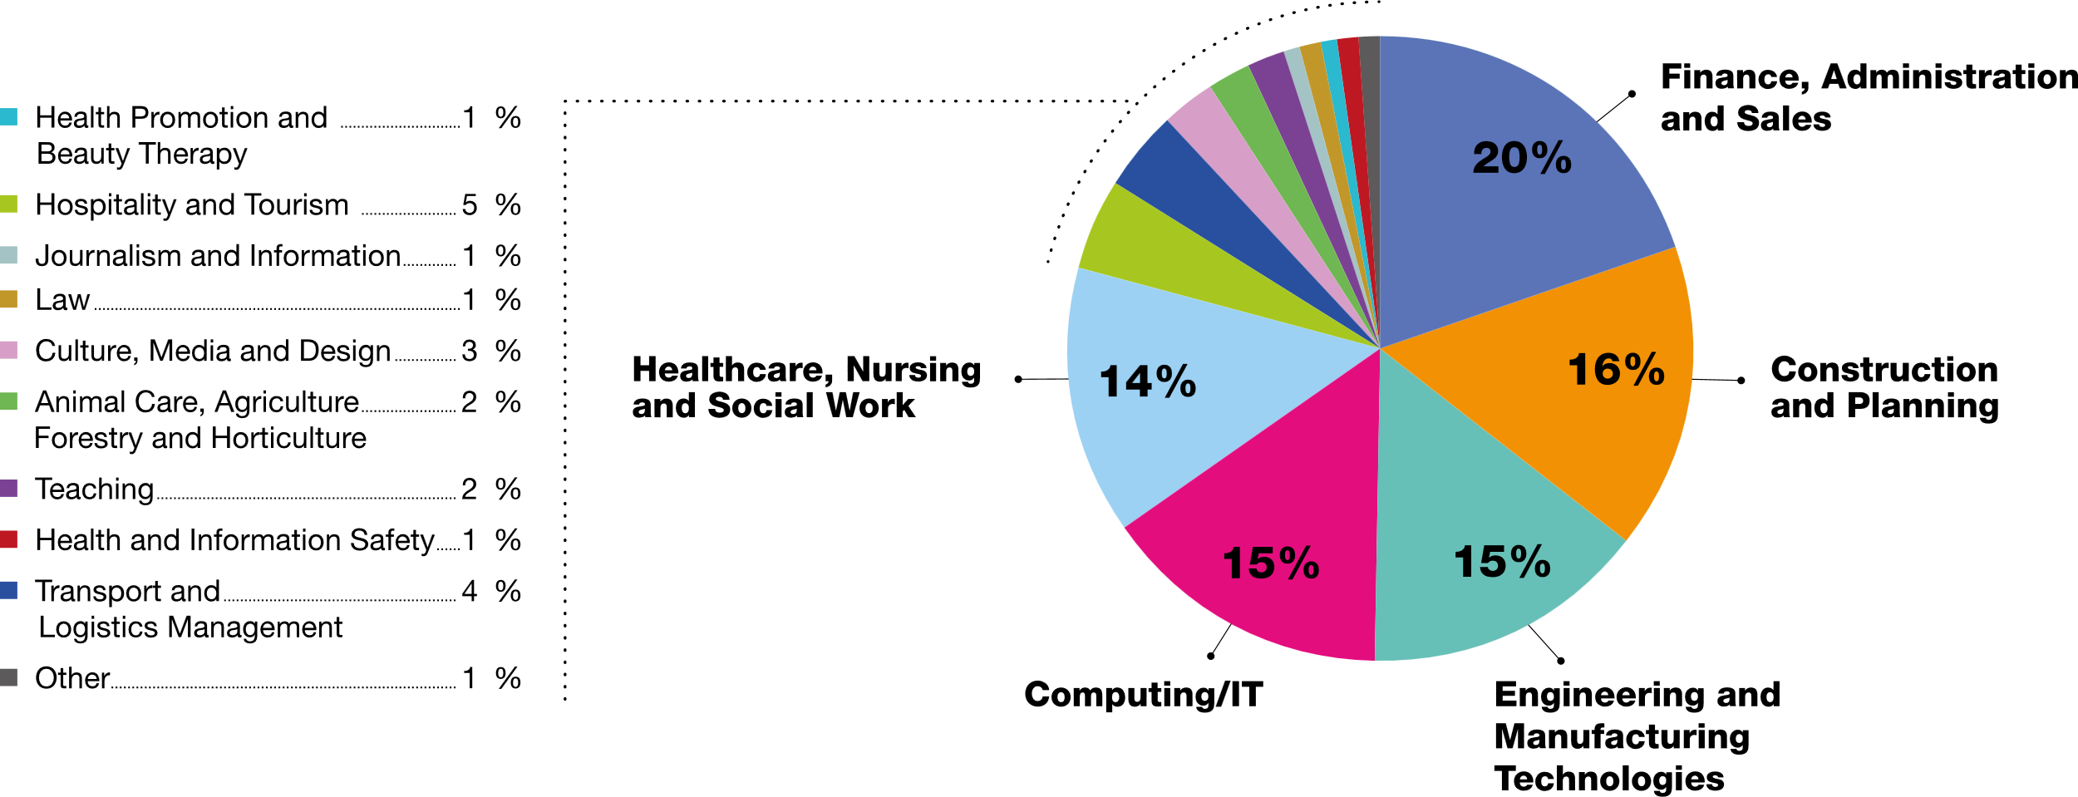
Distribution of places in HVE-programmes
Finishing in 2018–2024 per field of study

Slide 20
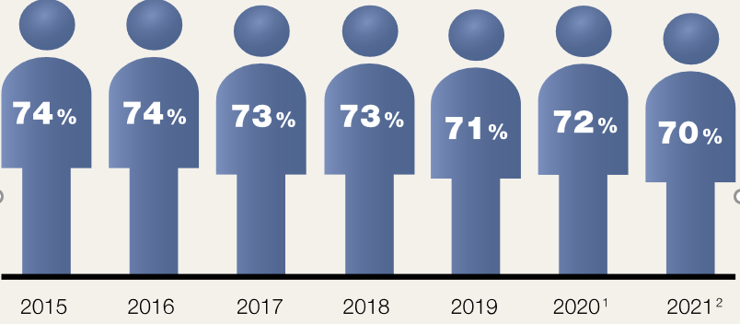
Graduation rate
Preliminary
Prognosis

Slide 21
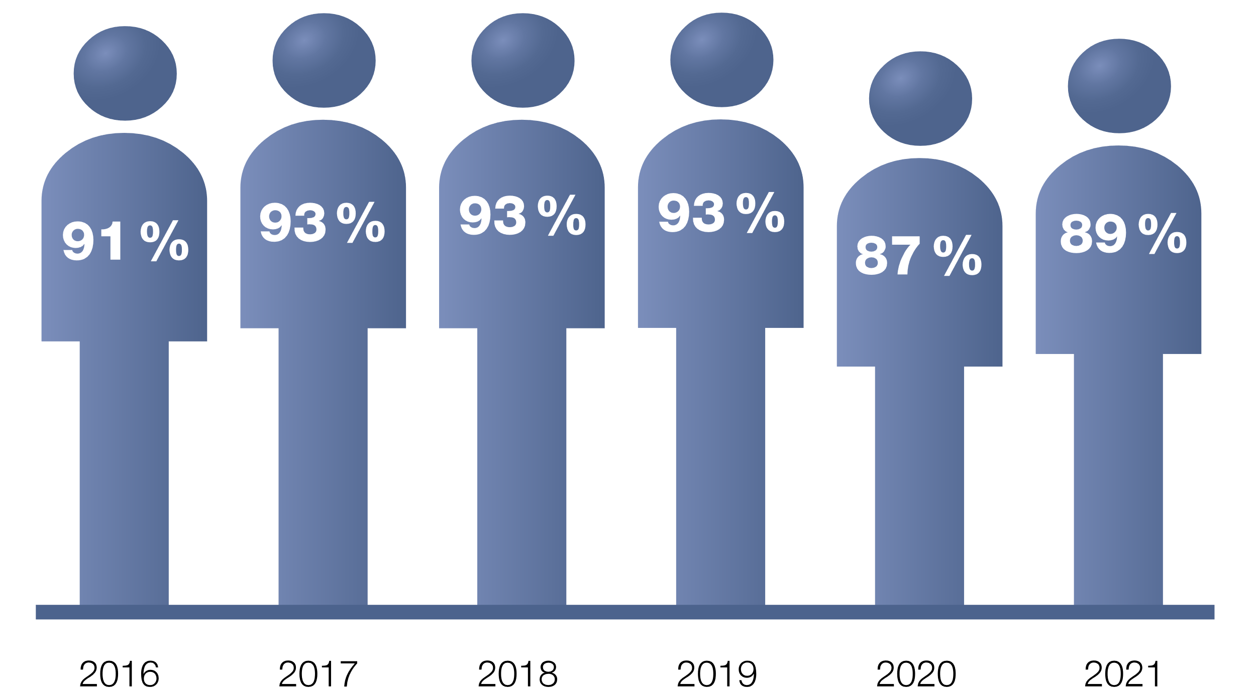
Employment rates
A year after graduation.

Slide 22
Results - Programme Quality Reviews
From the left 2017, 2018, 2019, 2020

Slide 23
New forms of HVE

Slide 24
Short courses within HVE
Strengthen the opportunity for skills development and prepare individuals for changes in the labor market
Swedish HVE can be become an more important tool in lifelong learning
Main target group: Those who need to renew their skills to keep their job (up-skill), move on to new more advanced tasks or change jobs in the working life (re-skill)

Slide 25
Short courses within HVE
First application period was in February 2020
Priority areas are courses that meet the need for increased expertise in digitalisation, automation, energy efficiency, climate change and sustainability
In total 317 approvals of funding
20,000 study places so far
12, 000 students have started courses
E.g courses within welfare technology, data analysis, cyber security, real estate automation, smart electricity networks and sustainable development in textiles and fashion

Slide 26
Prerequisites for funding of short courses
Responds to the needs of working life
Co-financed by employers
Have a suitable regional or national location based on the needs of the workplace
Design based on flexibility and what working life demands
Great emphasis on course providers’ previous results
Notes:
Data / IT: Agil test automator, Front-end developer, UX designer Finance: Sustainability Controller, Social Content & Influencer Marketing, Sustainability in E-commerce, System Understanding for Accounting Economists Hotel, restaurant and tourism: Sustainable events, Climate-smart food Healthcare: E-health, Intercultural competence in healthcare Garden: Sustainable ecosystems in practice Construction: BIM for supervisors, Operational optimization Security Services: Cyber ​​Security Technology: 3D, Automation technology for operating technicians, Smart industry

Slide 27
Priorities during the corona pandemic
Priority of education that targets industries that have been heavily influenced by the corona pandemic
Digital events, sustainable digital transformation and revenue management in the hospitality industry
Microbiology, health care and infection protection, palliative care and care philosophy, logistics and e-commerce etc
The courses cover anything from 2 weeks to almost 6 months
More than 80 percent of distance learning

Slide 28
Short courses within HVE
“Implementing short courses within HVE is the best initiative the Swedish education system has experienced in a long time.”
Notes:
The Institute for Evaluation of Labour Market and Education Policy
the Swedish Confederation of Professional Associations (Saco)
The Swedish Confederation of Professional Employees (TCO)
Confederation of Swedish Enterprise (SN)
The Swedish Federation of Business Owners

Slide 29
The HVE-flex
Student enrolled into HVE programme
Individual study planning
HVE degree (full qualification)
Identification & assesment of prior learning
Exemption (full or parts of courses)
Individual complementary training
HVE-flex study places are linked with a specific programme – same what (learning outcomes)
HVE-flex has a flexible how, when and where (agreed in individual study plan)
Reduced study time by 50 percent on average

Slide 30
Thank you for your attention!

